Slide 1
School Counselors and Evidenced base practice:
Karen Griffith
Mark Kuranz
February 6, 2019

Slide 2
What do you need to be an evidence-based school counselor?

Slide 3
Learning outcomes:
Participants will be able to:
Identify a variety of resources for best practices
Construct better activities and interventions based on quality resources
Employ a rubric for selecting activities/interventions/resources

Slide 4
EB School Counselors…
Clearly Identify Need
MS&B
Contextual data/Surveys
Others
Collect and analyze data
School Data Profile
School Improvement Plans
Select Activities
Professional Literature
Empirically Based Programs
Action Research (Results Reports)

Slide 5
EB School Counselors…
Build partnerships
Other Practitioners
Stakeholders
Professional Organization
Measure student outcomes
Process, Perception, Outcome
Meaningful Methods
Share results
Stakeholders
Professional Organization

Slide 6
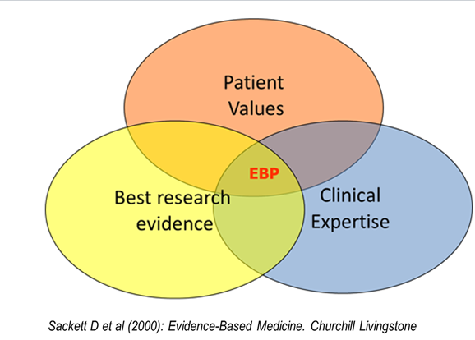
Evidence Based Practice
Notes:
The goal of EBP is the integration of:
clinical expertise/expert opinion,
external scientific evidence,
client/patient/caregiver perspectives
to provide high-quality services reflecting the interests, values, needs, and choices of the individuals we serve.
American Speech

Slide 7
Evidence Based
Empirically Supported
It’s in the research.
Data-Based Decision Making
It’s intentional.
Professional Judgment
It’s consultation, collaboration, and collegial.

Slide 8
for

Slide 9
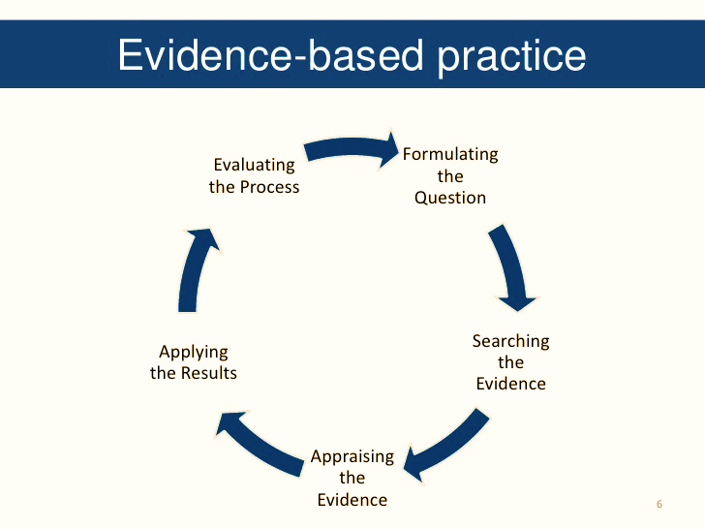
Did it work for me?
What do I do?
Has it worked before?
I’ll do it this way?
Will it work for my group?

Slide 10
Evidence Based Practice
Ask the question
Acquire the best evidence
Appraise the evidence
Apply
Assess Effectiveness & Efficiency
Tell

Slide 11
Evidence Based Practice
2) Find what might work
Resources
What Works Clearinghouse, CSCORE, SCALE
Action research
Personal, Colleagues, Conferences, Trainings

Slide 12
Evidence Based Practice
1) Identify Need
School Data Profile
Contextual Survey
SIP
MS&B
Developmental needs
Others
Notes:
We could talk about and/or show examples of each. We could do the slides on data profile.

Slide 13
What Works Clearinghouse http://ies.ed.gov/ncee/wwc/
resource for informed education decision making
identifies studies that provide credible and reliable evidence of the effectiveness of a given practice, program, or policy

Slide 14
The Ronald H. Fredrickson Center for School Counseling Outcome Research & Evaluation (CSCORE) http://www.umass.edu/schoolcounseling/index.php
identifying and developing research-based and effective school counseling practices
conducts and disseminates findings from research about career, social/emotional, and academic interventions
provides K-12 leaders and practitioners with information about data-based decision-making, evidence-based practices, and program evaluation
provides international leadership in the measurement of the outcomes of school counseling interventions and programs.

Slide 15
SCALE Research Center
RAMP Results Reports:
Core Curriculum
Small group
Closing-the-gap
https://scale-research.org

Slide 16
Evidence Based Practice
3) Plan what to do
Action Plans (Core Curriculum, Small Group, Closing-the-Gap)
Prepare (delivery, structure, schedule, activities,
supplies, materials, etc.)
Develop Pre/Post Assessment
Document Outcome Data Baseline

Slide 17
Evidence Based Practice
4) Do
Administer Pre-test
Deliver
Administer Post-test

Slide 18
Evidence Based Practice
5) Measure & Analyze
Administer Post-test
Document Outcome Data
Determine what worked/what did not
Results Reports (documentation)

Slide 19
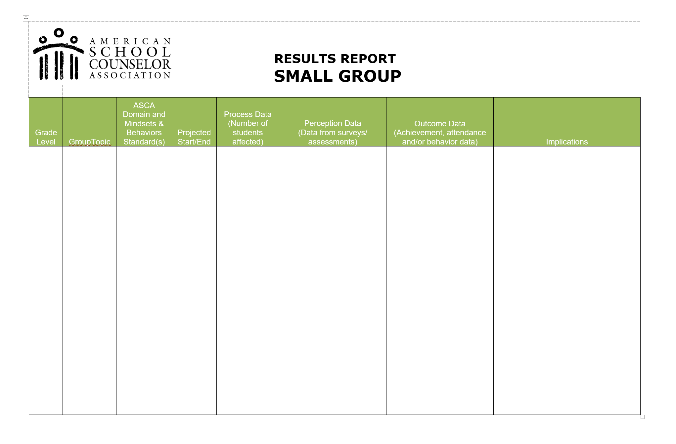

Slide 20
Evidence Based Practice
6) Tell
Students, Teachers, Parents, Admin
Advisory Council, Faculty, BOE
Info-Graphics, PPT (3-5 slides)

Slide 22
Academic Achievement Evidence Based Resources
Check & Connect (K-12)
I Can Problem Solve (PK – 6th)
Student Success Skills Program

Slide 23
Check & Connect K - 12
Only drop program on What Works Clearinghouse
Mentor Training
Many positive results
University of Minnesota
$35 - $50 per manual

Slide 25
I Can Problem Solve PreK – 6th
Vocabulary work
Feelings identification
Alternative solutions
Consequential thinking
Lots of lessons (50 – 80) many times a week
Under $50
Research Press

Slide 26
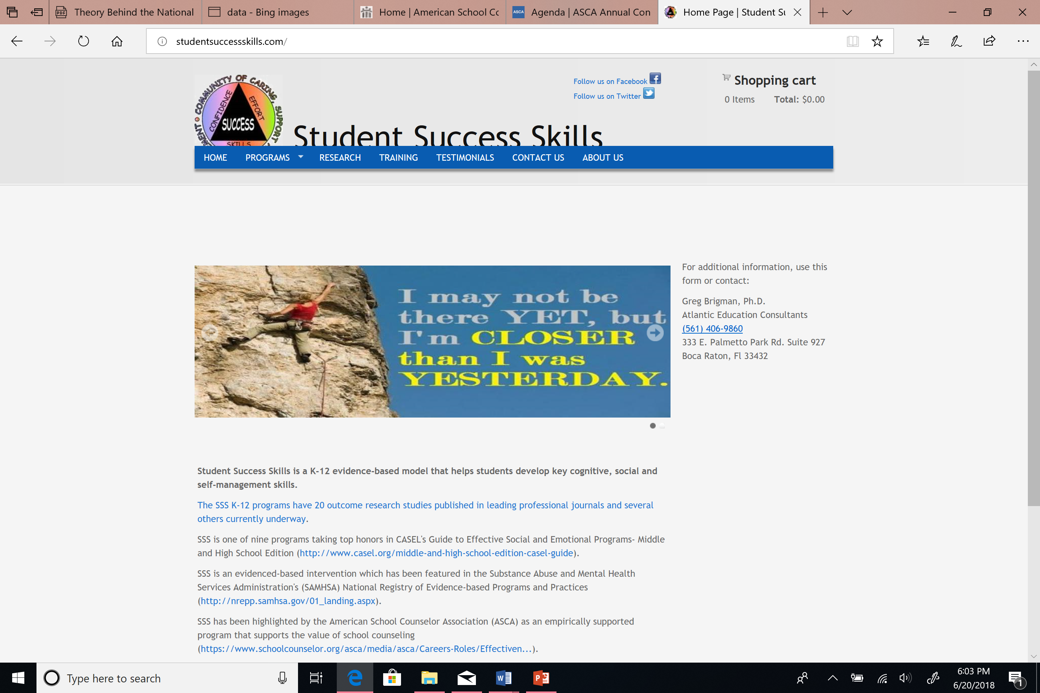
Student Success Skills K-1, 2-3, 4-12+
Widely used
Highly effective
Strongly endorsed
Develops cognitive, social, & self-management skills
Different Programs
Ready to Learn
Student Success Skills
College/Career Success Skills
$195 K – 1st
$75 2nd – 12th

Slide 27
Behavior Evidence Based Resources
Conscious Discipline
The Good Behavior Game

Slide 28
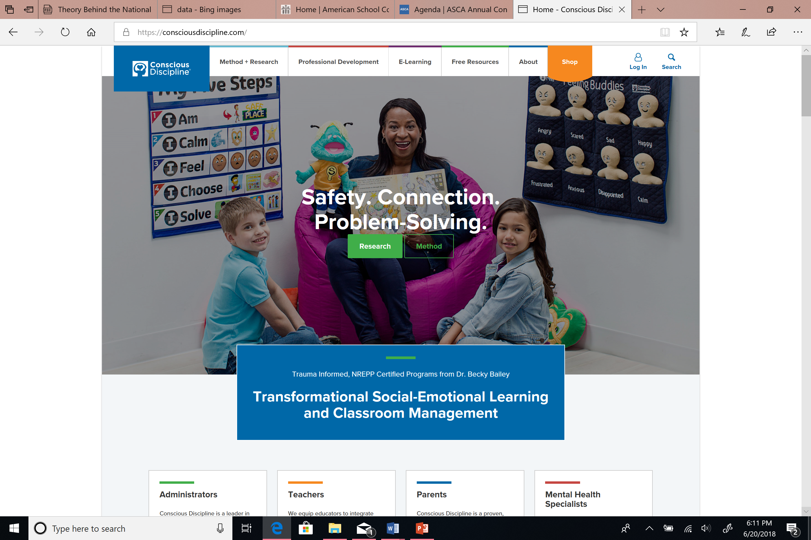
Conscious Discipline
Highly rated & validated
Children
Social emotional learning
Discipline
Self-Regulation
Free resources online

Slide 29
Good Behavior Game
Self regulation
Self management
Delayed gratification
Benefits in classroom
Increased mental health
Substance abuse prevention
$240+ per kit

Slide 30
Olweus Bullying Prevention (K-12)
Widely used
Everyone participates
50%+ reductions in problem behaviors (bullying, vandalism, school violence, fighting, theft, truancy)
Pricing varies by packaging

Slide 31
Social Emotional Skill Development Evidence Based Resources
LifeSkills Training
Lions Quest
Morningside Center for Teaching Social Responsibility

Slide 32
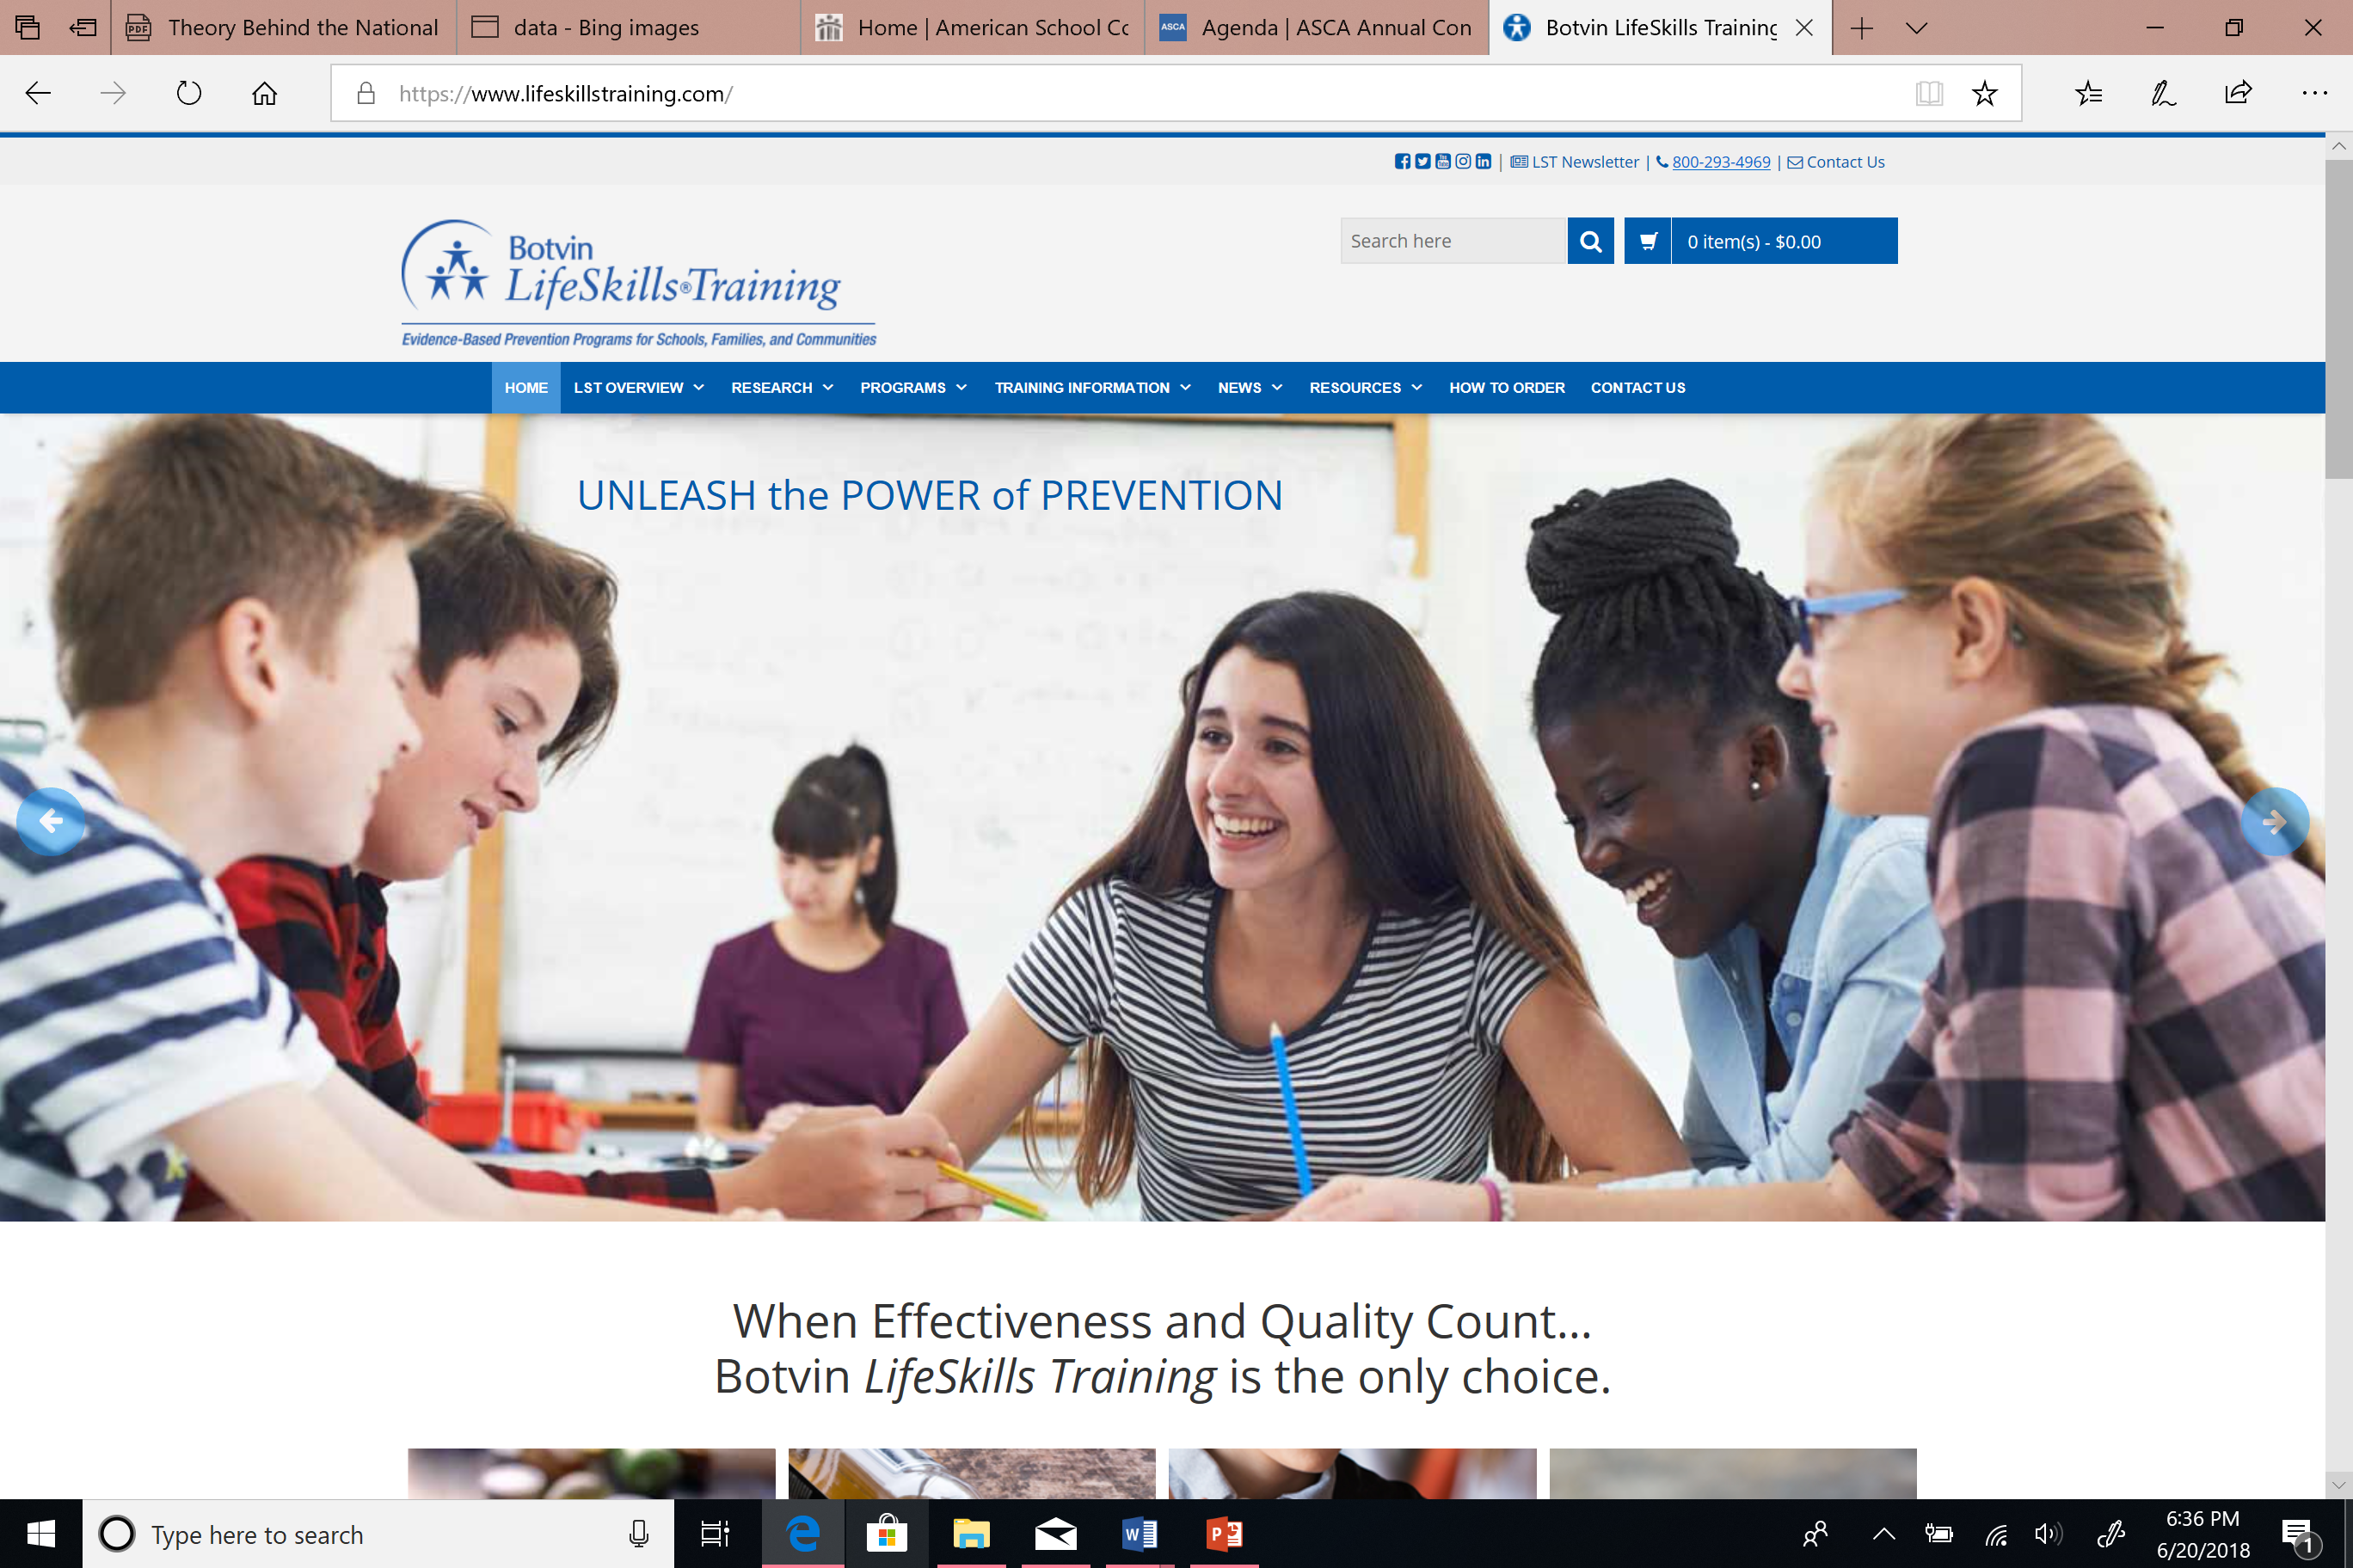
LifeSkills Training
Multiple programs available for elementary, middle, and high school
Online workshops
Drug resistance skills
Personal self management skills
General social skills
Prices vary depending on product

Slide 33
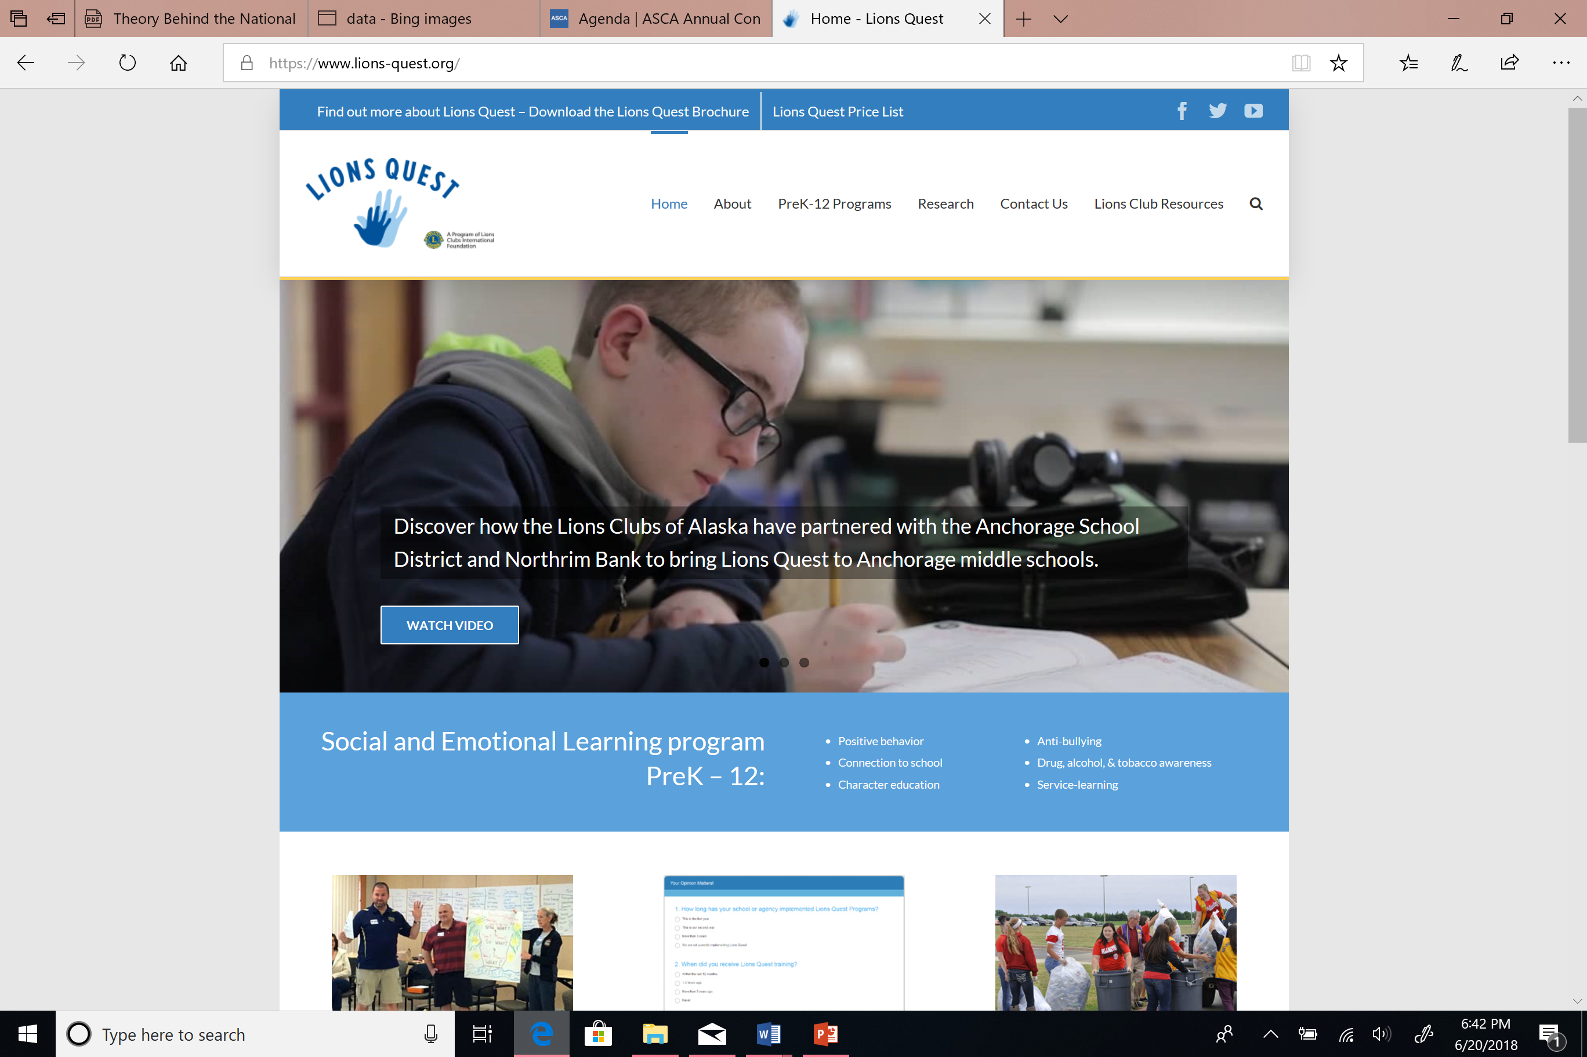
Lions Quest K-12
Social and emotional learning program
Positive behavior
Connection to school
Character education
Anti-bullying
Drug, alcohol, tobacco awareness
Service learning
$120-$150 classroom set

Slide 34
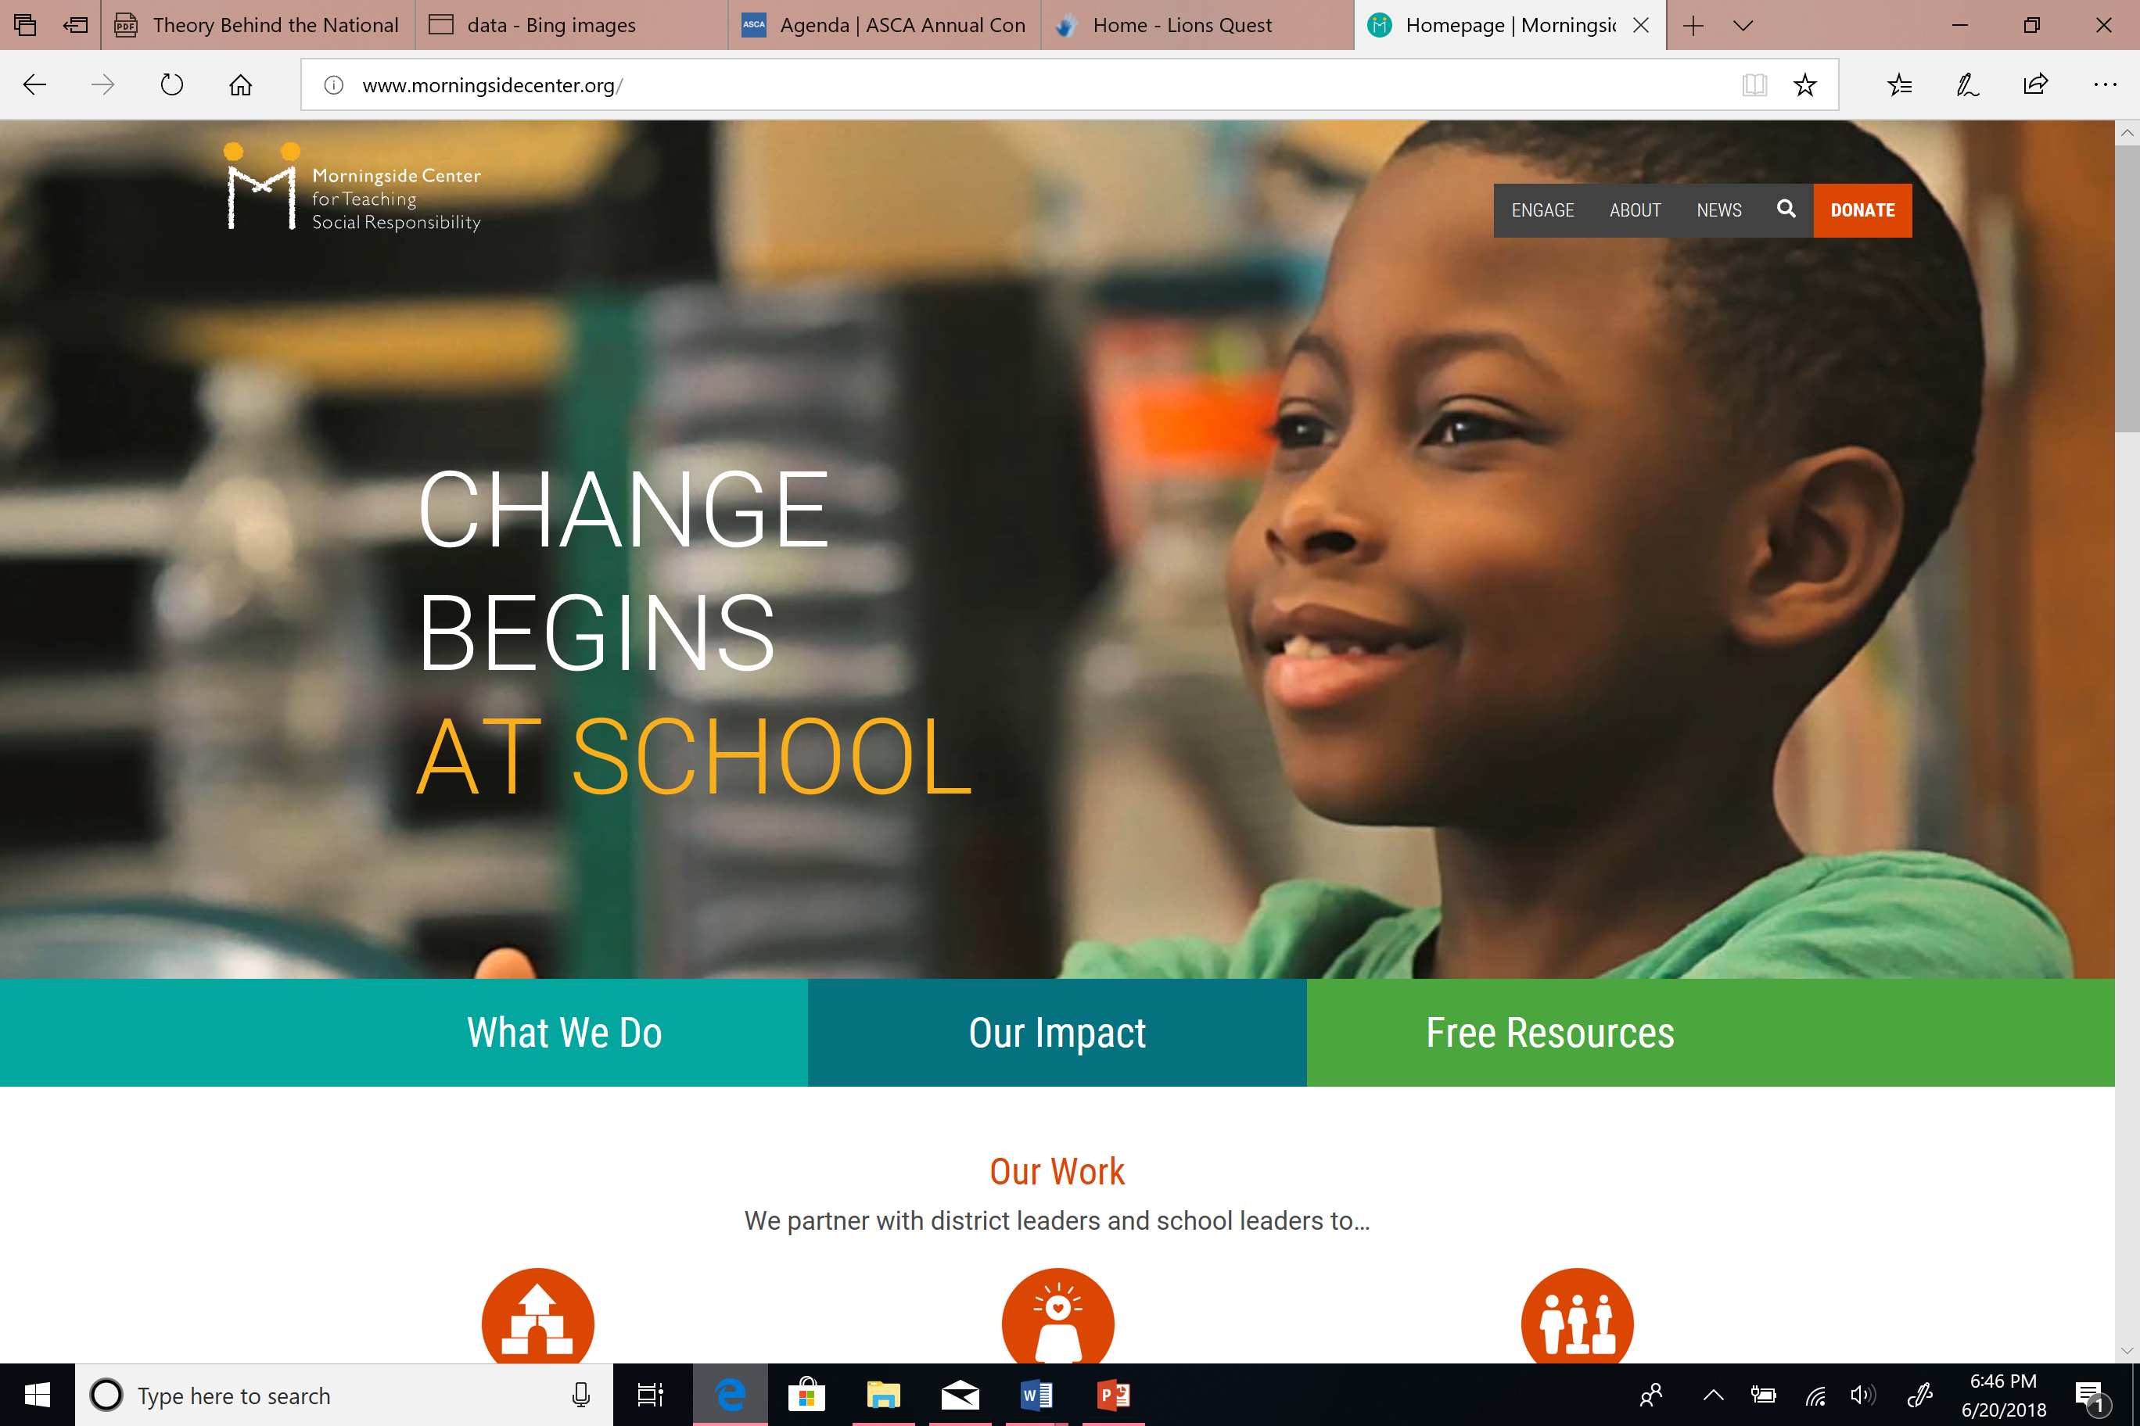
Morningside Center for Teaching Social Responsibility K-12
Offers coaching & workshops
Curriculum based programs
Designed to:
Social Emotional Learning
Restorative Practices
Build Community
Strengthen social emotional skills
Increase equity through courageous conversations

Slide 35
Attendance Plan
Evidence Based Practice Worksheet

Slide 36
You get:
Citation
Abstract
Take-Away
of 31 Articles

Slide 37
Academic Development Articles:
School Counseling & Student Outcomes: Summary of Six State Studies
A Comparative Analysis of RAMP vs Non-RAMP Schools
Ratios Matter, Especially in High-Poverty Schools
Addressing the AP Placement Equity & Excellence Gap for AA Students
Closing the Achievement Gap of Latina/o Students
A Comprehensive Results-Driven Counseling Method
A Counseling Intervention for Underachieving Students
Psychoeducational Group Approach to Increase Study Skills & GPAs (9th grade students)
A Group Counseling Approach to Improve Test Performance of AA Students
Student Success Skills

Slide 38
College & Career Readiness Articles:
Effects of HS College Counseling on College App Rates
Estimating Causal Impacts of School Counseling with Regression Discontinuity Designs
CCR Services & Smaller Ratios Benefit Students
Does the Availability of Counseling Affect College-Going Decisions Among Highly Qualified 1st-Gen College-Bound Students?
Who Sees the School Counselor for College Information?
School Counselors Supporting African Immigrant Students’ Career Development
Providing College Readiness Counseling for Students with Autism
Transitioning Hispanic Seniors from HS to College
Identifying Exemplary School Counseling Practices

Slide 39
Social-Emotional Development Articles:
Access to Services & Student Outcomes
Outcomes of School-Wide PBS Program
A School-Based Group Intervention for Families of Children Who Are Disruptive
A Social Norms Campaign to Reduce Rumor Spreading in Jr HS
A High School Counselor’s Leadership in Providing School-Wide Screenings for Depression & Enhancing Suicide Awareness
Use of Group Counseling to Address Ethnic Identity Development

Slide 40
Other Articles:
Schools’ Mental Health Services & Young Children’s Emotions, Behavior, and Learning
Are School Counselors an Effective Educational Input?
A State-Wide Evaluation of the Outcomes of the Implementation of ASCANM programs in rural and suburban Nebraska HS
School Counseling Outcome: A Meta-Analytic Examination of Interventions
Review of School Counseling Outcome Research
Maximizing School Counselors’ Efforts by Implementing School-Wide PBIS

Slide 41
A Big Why
Deserves a Big

Slide 42
Thank You
kggfarm@gmail.com
mkuranz@wi.rr.com

