Slide 1
It's RAMP Time: Why and How
2019 WSCA Annual Conference The Power of Hope Monona Terrace Convention Center Madison, WI
February 6, 2019
Mark Kuranz Marquette University Adjunct Professor WSCA/ASCA Past President ASCA Model/RAMP Trainer

Slide 2
RAMP vs. Model
Need to read books
ASCA National Model, 3rd edition
Making Data Work
ASCA National Model Implementation Guide
Do not depend on the 12 rubrics to fully explain the components

Slide 3
Model vs. RAMP
National Model
RAMP
Comprehensive Developmental Counseling Program
Total Program
Continual, On-Going
An Award –snap shot of the program
Exemplary Samples
Due in October

Slide 4
RAMP - Why?
Evidence based practice
Empirical Research Studies Supporting the Value of School Counseling
Good for students
Legitimizes the professional
Engages stakeholders
Annual agreement – component 5
Advisory council – component 6
Program evaluation
Professional development/reflection
National recognition

Slide 5
EMPIRICAL RESEARCH STUDIES SUPPORTING THE VALUE OF SCHOOL COUNSELING
School Counseling and Student Outcomes: Summary Of Six Statewide Studies
Carey, J., & Dimmitt, C. (2012). School counseling and student outcomes: Summary of six statewide studies. Professional School Counseling, 16 (2), 146-153. doi: 10.5330/PSC.n.2012-16.146
Take-away: A growing body of research indicates
comprehensive, data-driven school counseling programs improve a range of student learning and behavioral outcomes.

Slide 6
Some of the School Counseling Researchers
Carey, Harrington, Martin, & Hoffman, 2012
Dimmitt & Wilkerson, 2012
Ward, 2009
Lapan, Gysbers, Sun, 1997
Lapan, Gysbers,Petros, 2001
Sink, Stroh, 2003
CSCORE – Carey & Harrington, UMASS

Slide 7
Comprehensive School Counseling Program Research
Increased
Graduation Rates
Math and reading
3rd grade reading proficiency
Scores on state tests
ACT scores
Students taking ACT
Perkins Program completion
Attendance

Slide 8
Comprehensive School Counseling Program Research
Decreased
Suspension rates
Discipline referrals
Student reports bullied/teased

Slide 9
Regardless of socioeconomic level,
children who remain in the same school for multiple years
with a well-implemented
comprehensive school counseling program
will have higher achievement test scores
than students who attend schools
without such a counseling program
150 Randomly Selected Public Elementary Schools in Washington State
(Sink, Stroh, 2003)

Slide 10
Annual Agreement

Slide 12
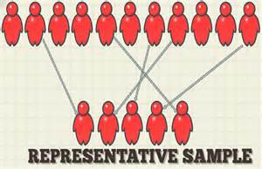
Advisory Council Description
A representative group of stakeholders to review and advise the implementation of the school counseling program.

Slide 13
Effective Advisory Councils
A list of the advisory council members and their stakeholder positions.
The agendas and minutes from at least two meetings –
fall - share program goals
spring - share results and implications

Slide 14
Program Assessments

Slide 15
RAMP Assessment

Slide 16
RAMP and the National Model help us to more effectively evaluate our program and pinpoint areas of need. Through collaboration with the School Improvement Team, we connect our school counseling program goals to the overall goals of the school. This makes us an integral part of the school improvement process and makes the work that we do invaluable in the eyes of our stakeholders.
--2015 RAMP School

Slide 17
RAMP – How?
Know it’s a multi-year process
ASCA web site
Read RAMP recipient's applications
Use RAMP resources
Read the rubric, read the rubric, read the rubric
Complete a program assessment
Create implementation plan
Start with 1 or 2 components
Identify mentor
Use resources
Implementation guide
Webinars
ASCA articles
ASCA – U

Slide 18
RAMP Application Process 12 Components
Notes:
Note the point values – this is a recent change!

Slide 19
Points
Notes:
Score needed for RAMP award

Slide 20
Resubmission
Notes:
Minimum score needed to be able to resubmit
(48 – 53 points gives applicant chance to resubmit)
May note: application returns to same review team. Team reads only the portions that have been edited.

Slide 21
Narrative
300 – 750 words
Video
Check the web site for examples

Slide 22
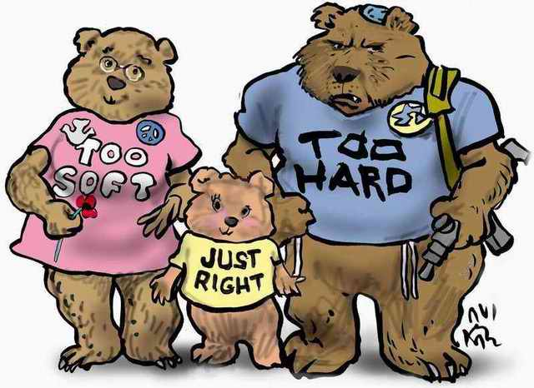
Supplemental Documentation
Notes:
Be like goldilocks
Not too much
Not too little
Choose carefully and thoughtfully
Trainers –
You might want to ask about possible examples of supplemental documentation for each of the 12 components – whether there should be any and what should it be
Does this component need any supplemental documentation?
What supplemental documentation might be helpful? What will further the knowledge of the RAMP reader?
Be discerning!

Slide 23
Need help applying for RAMP? Want to know if it's worth your time? Not sure how to get started? www.schoolcounselor.org
Scoring rubric
Examples of outstanding RAMP applications
RAMP tips checklist

Slide 24
RAMP Scoring Rubric: Section Webinars
Section 1: Vision Statement
Section 2: Mission Statement
Section 3: School Counseling Program Goals
Section 4: ASCA Mindsets & Behaviors for Student Success
Section 5: Annual Agreement
Section 6: Advisory Council
Section 7: Calendars
Section 8: School Counseling Core Curriculum Action Plan and Lesson Plans
Section 9: School Counseling Core Curriculum Results Report
Section 10. Small-Group Responsive Services
Section 11: Closing-the-Gap Results Report
Section 12: Program Evaluation Reflection

Slide 25
Additional Helpful Webinars
RAMP Rubric Ready
ASCA National Model Implementation Guide
Making DATA Work
RAMPing as a Solo School Counselor

Slide 26
Videos
Why #RAMPUp? Check out these videos from some RAMP schools explaining why they went through the RAMP process -- and what they learned along the way.
Journey to RAMP: Charleston School of the Arts
Journey to RAMP: Nanaikopono Elementary School, Hawaii
Journey to RAMP: Cactus Shadows High School
Journey to RAMP: Sequoia Middle School
Journey to RAMP: Hayfield Secondary School
Journey to RAMP: John F. Kennedy High School
Journey to RAMP: Quander Road School & New Directions Alternative Education Center

Slide 27
Webinars
Foundation
ASCA National Model – Themes and Foundation
RAMP: It Starts Witih Vision and Mission
Creating Effective School Counseling SMART Goals
ASCA Mindsets & Behaviors for Student Success
Focus on Student Competencies: ASCA Mindsets & Behaviors for Student Success
Using Data to Develop SMART Goals, Lake Braddock Secondary School
Management
ASCA National Model – Management
Evidence-Based, Data-Driven Comprehensive School Counseling: How it Fulfills RAMP
Accountability
ASCA National Model – Accountability
Perception Data: Learn to Identify, Create, Analyze and Share It
Closing the Gap and Writing Results Reports
Program Evaluation Reflection (section 12 of the application): Sample Video response

Slide 28
ASCA School Counselor Magazine Article
Now is the Time
Don’t have a comprehensive school counseling program yet? Let this be the year you finally get started.

Slide 29
Follow the Rubric!
Notes:
Handout suggestion
Copy the most current rubric available from the website.
Delete all but the highest value point for each of the 12 component.
Create a bulleted list under the highest point value rubric for each component of what needs to be included.
Don’t forget to include the narrative in this document.
Becomes a 12-page handout on which participants can write notes.
They can also use it to attempt the “Your Turn” slides in this powerpoint.

Slide 30
Read the Rubric

Slide 31
The school counseling vision statement:
■ Describes the future world where student outcomes are successfully achieved.
■ States the best possible outcomes desired for all students that are five to 15 years away.
■ Aligns with the school and district vision statement (if available*).
Include:
The school counseling program’s beliefs
The school and/or district vision statements (if available*).
*If your school/district does not have a vision statement, indicate that in the narrative.

Slide 32
Vision Statement Narrative 3 Points/Exemplary:
The narrative includes a highly detailed explanation, including specific examples, of:
● The process for developing the vision statement.
● How the beliefs influenced the vision statement development.
● How the vision statement drives the school counseling program

Slide 33
Where to Start? P. 125

Slide 36
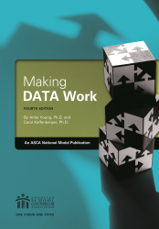
Resources

Slide 37
Exemplars in Implementation Guide
Beliefs: 10 – 12
Vision: 15 – 17
Mission: 19 – 23
School Data Profile: 34 – 35
Program Goals: 41 – 56
MS/B Planning Tool: 60 – 63
Perception Data Assessments: 67-68, 108, 110, 112, 116, 132
Use of Time Assessment: 74-75
Annual Agreement: 81 – 82
Advisory Council: 93 – 97
Annual Calendar: 102 – 103
Weekly Calendar: 104 – 105
Lesson Plans: 122 – 123, 130 – 132, 140 - 142
Core Curriculum Action Plan: 124 – 127
Results Reports: 162 – 163, 165, 168

Slide 38
Advisory Council (ANMIG p. 92)
Don’ts
Omit important stakeholders
Forget to check diversity of membership
Don’t create just for RAMP
Don’t be a subset of another committee
Don’t forget your data and goals presentation
Don’t ignore feedback
Do’s
Construct a representative membership
Include students, when appropriate
Meet at least twice
Present data and goals
Record and respond to feedback
Create and save agendas
Take detailed minutes
Provide good supporting documentation

Slide 39
ASCA U Specialist Trainings
Anxiety and Stress Management Specialist
Bullying Prevention Specialist
Career Development Specialist
Closing the Achievement Gap Specialist
College Admissions Specialist
Cultural Competency Specialist
Grief and Loss Specialist
Legal and Ethical Specialist
Mental Health Specialist
School Counseling Data Specialist
School Counseling Leadership Specialist
Students With Special Needs Specialist
Trauma and Crisis Specialist

Slide 40
Thank you
mkuranz@wi.rr.com
Notes:
(3:50)

