Slide 1
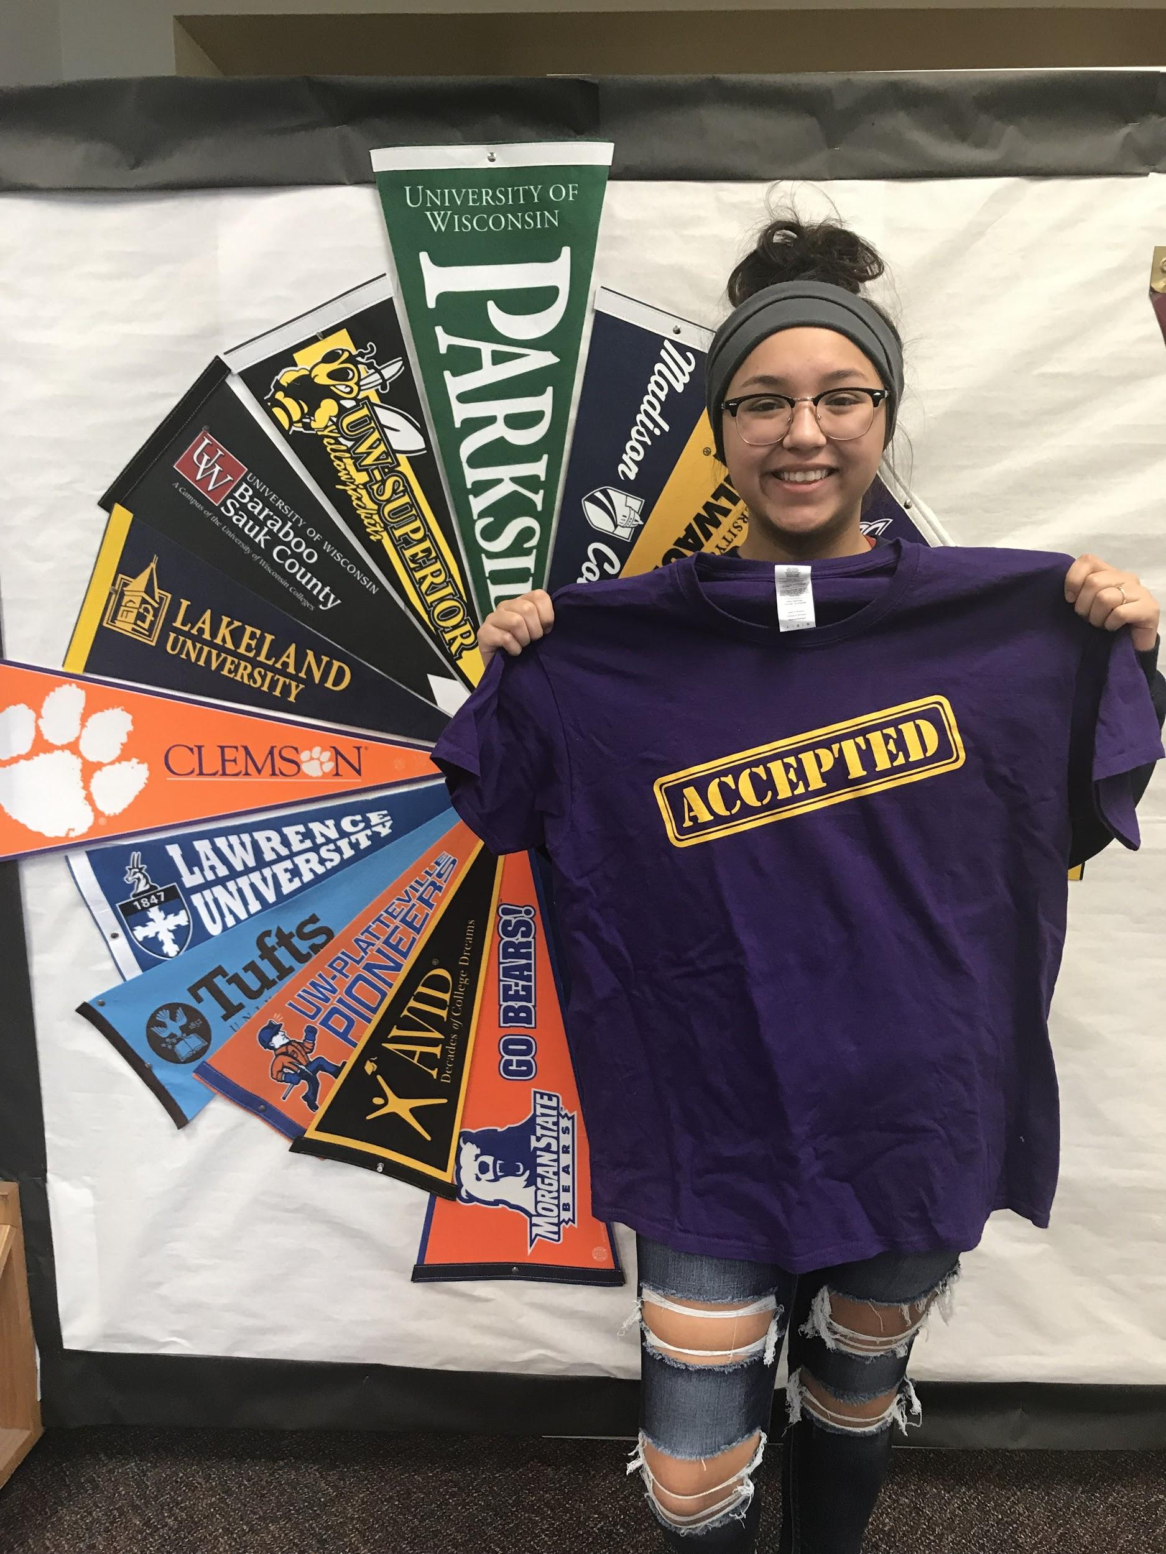
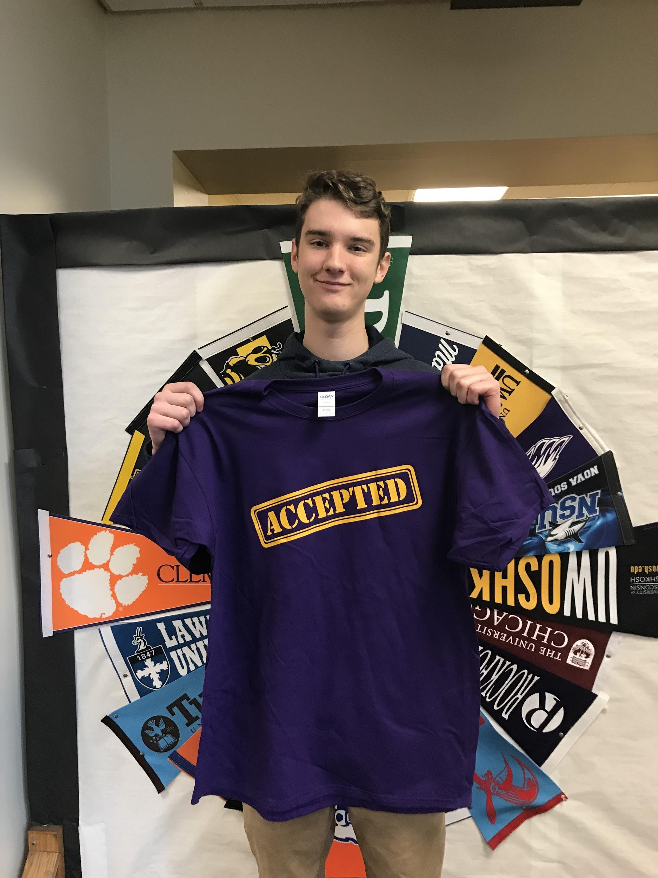
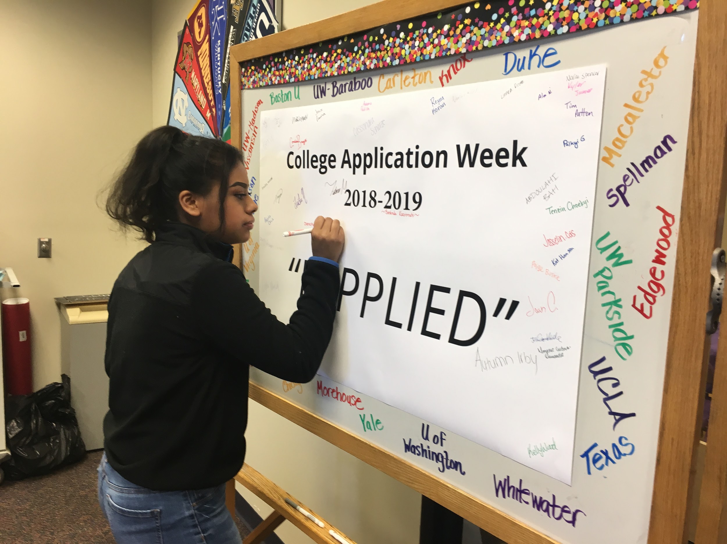
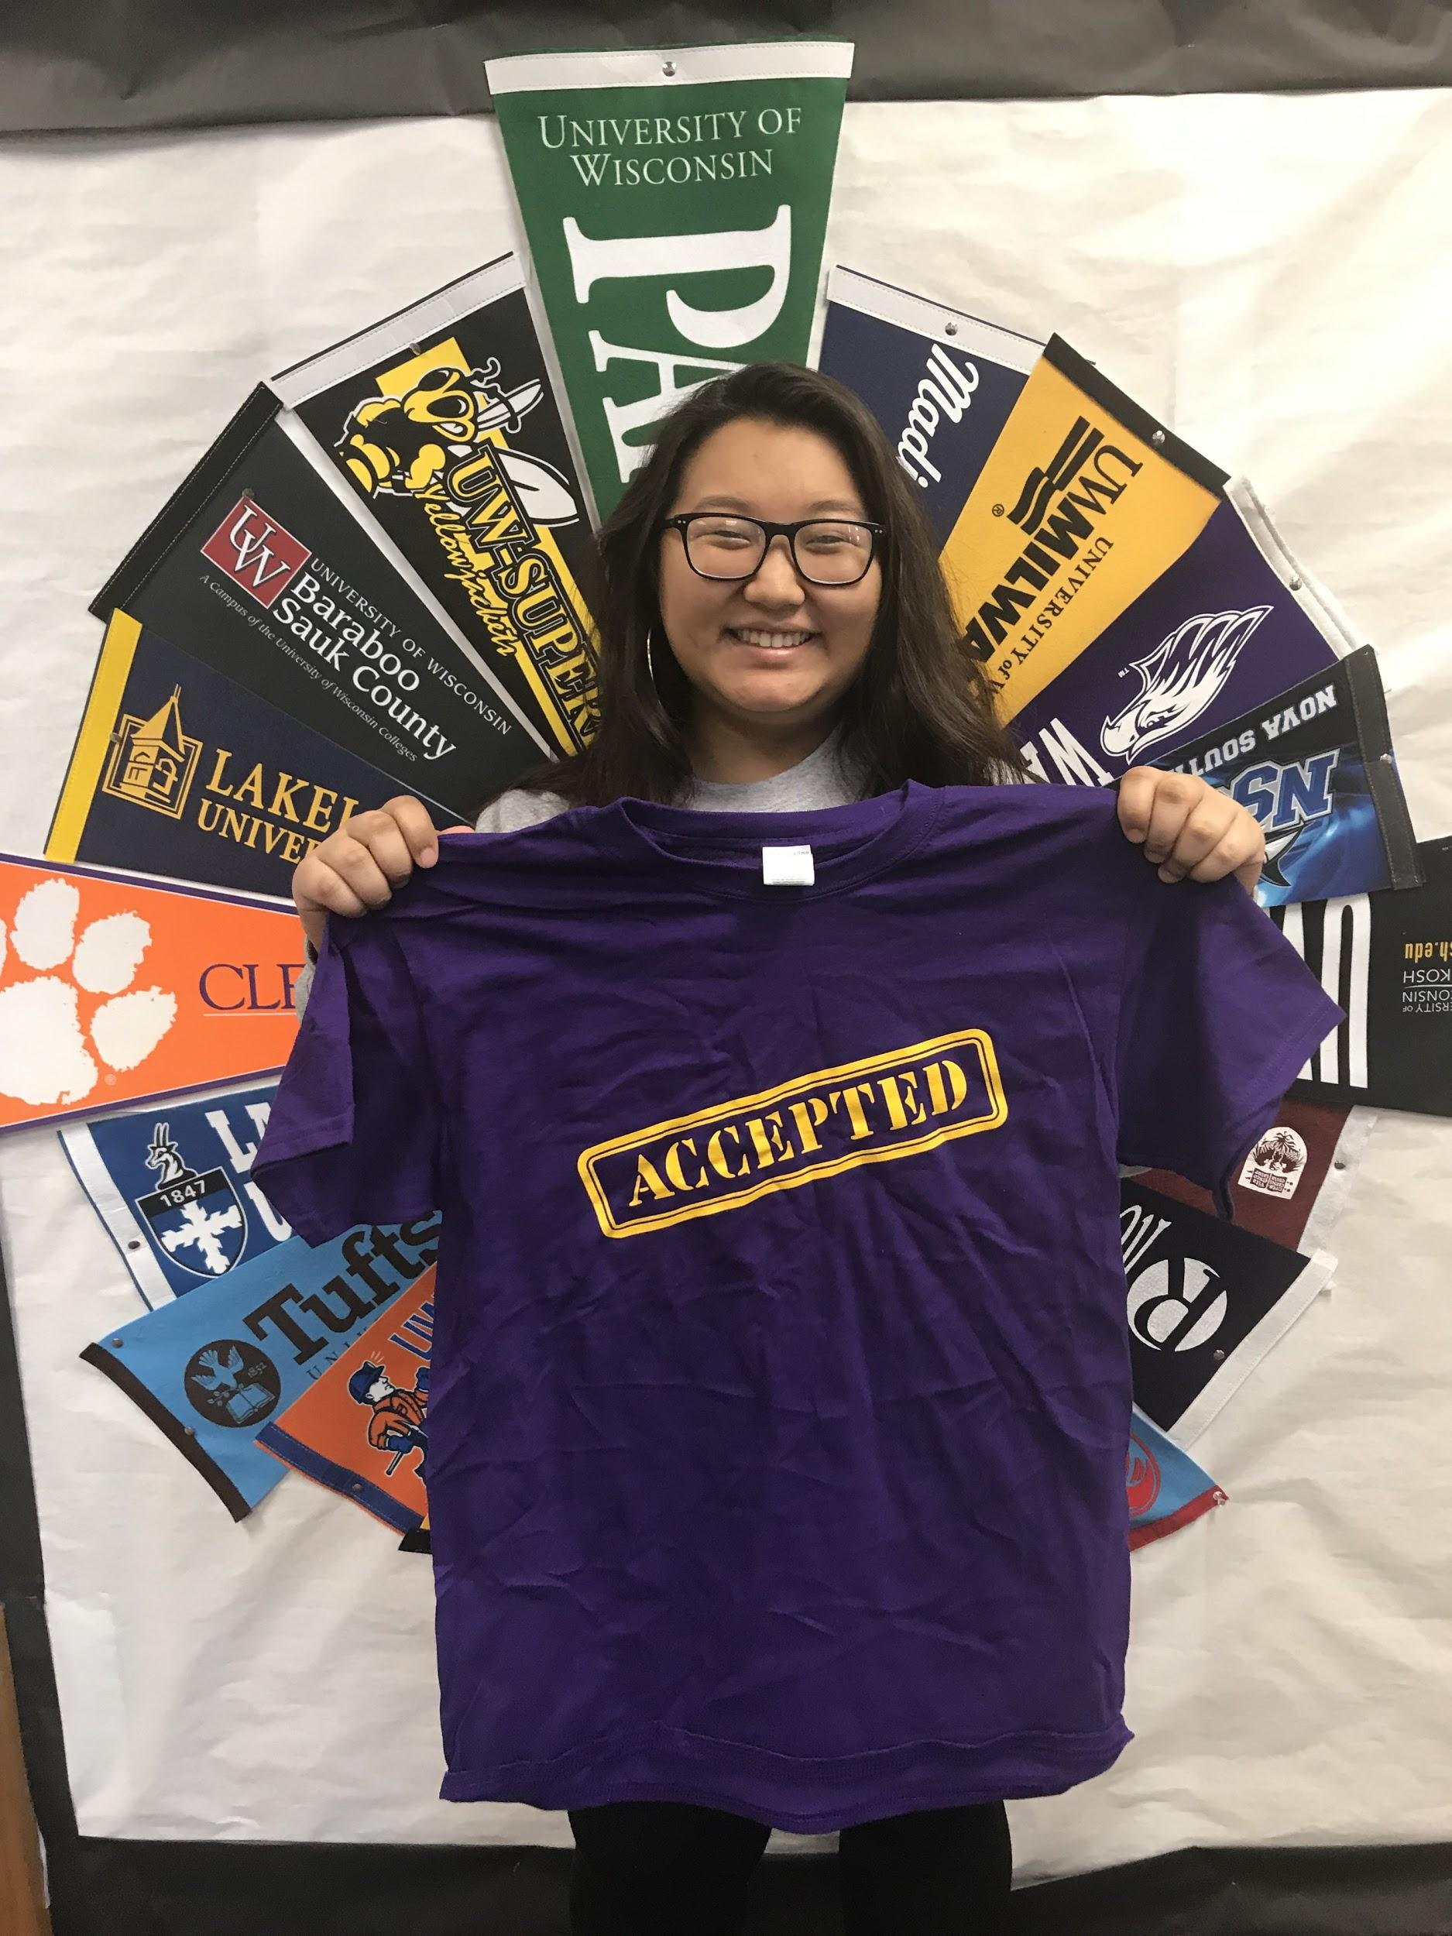
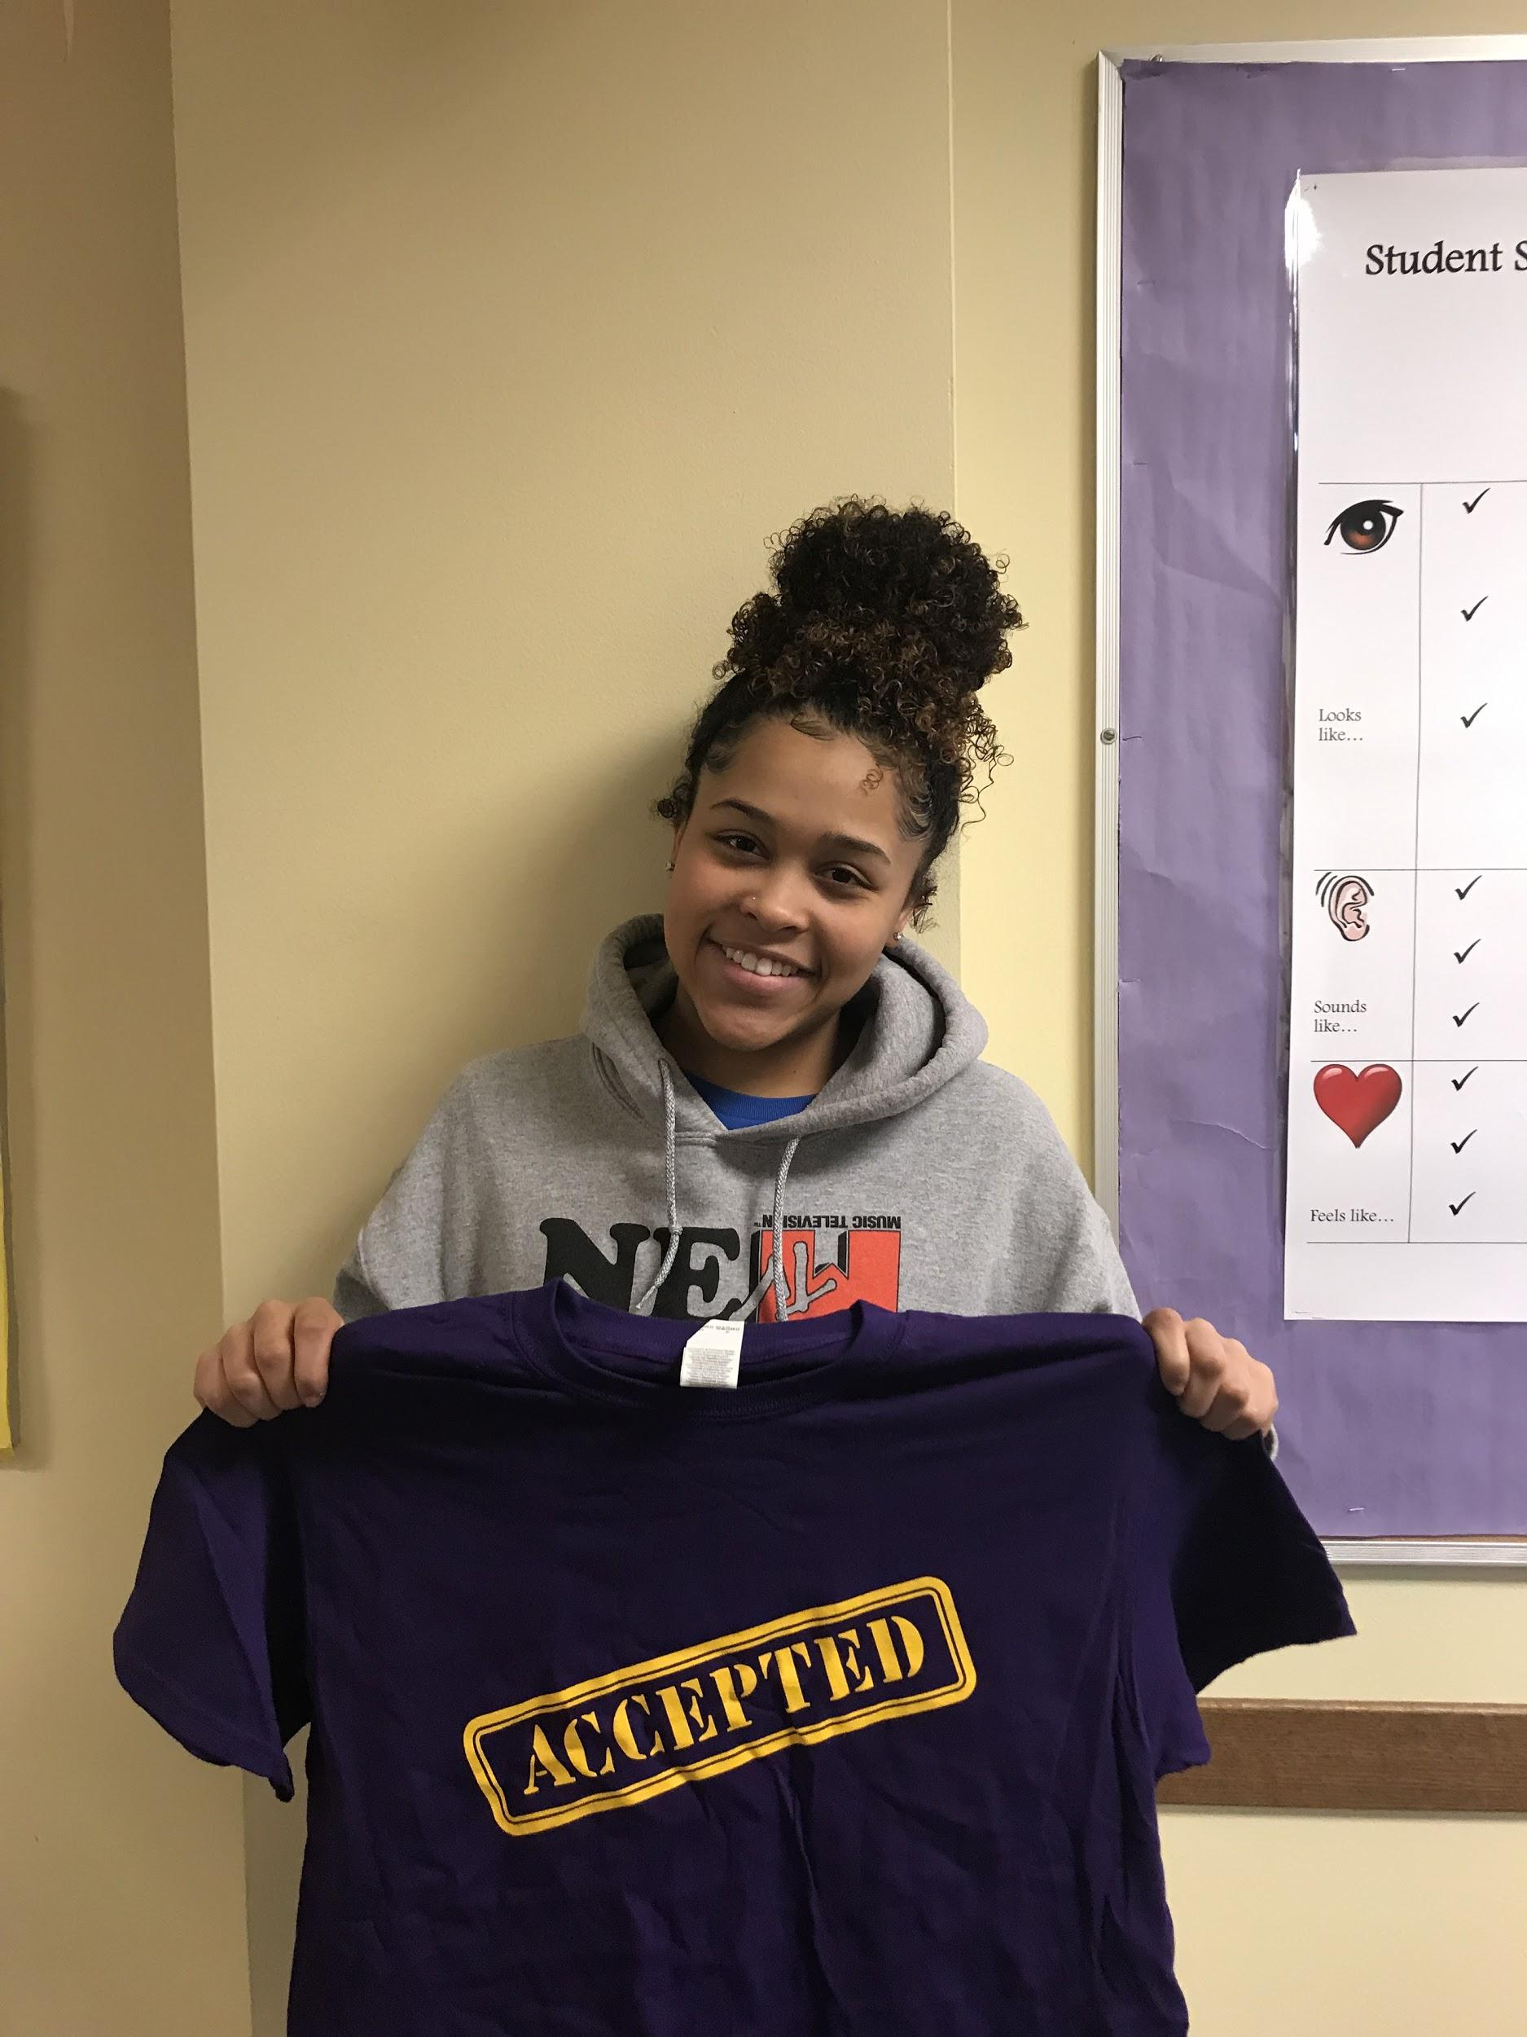
College Application Week
WSCA - 2019

Slide 2
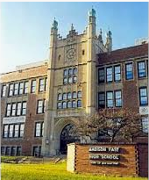
Demographics of East High

Slide 3
Why??
Make sure all students were getting support through the college application process
We knew AVID students were getting a lot of support, but many non AVID kids needed more support through the process
Lots of hurdles or barriers for students to overcome
We were meeting with many students individually and this allowed us to meet with all of our seniors at the same time (More Efficient)
English teachers collaboration
College nights - certain segments of student population were not represented at our evening events. We wanted to make sure all students were getting the information and support they needed!

Slide 4
Equity Vision for East High

Slide 5
Overview of the Week!
Every senior came to our career center to work on applications for between 2 and 5 days
Counselors, College Advisors, and Many volunteers were here to support students while completing the college application.
Dedicated work time
Highlighted all the steps with students (Application, Transcripts, ACT, Essay, Letter of Rec, etc)
English teachers were supporting reading and critiquing essays.
Celebrated students as they completed steps

Slide 6
Key steps to Implementation!
Team to help plan!
Partnerships (WI Go to College Campaign, Teachers, College Representatives, District Support, Administration
Funding - T-shirts, prizes, posters (PBS and Administration)
Creating a schedule with English Teachers
Plan for Needed Technology
Promote College Culture across staff - Teachers and staff wearing college gear all week!

Slide 7
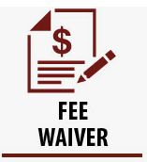
Key Topics Covered!
Mini Lessons
ACT - Sending Scores
Transcripts
Letters of Recommendations (Brag Sheet, Ettique)
Common Application
Black Common Application
UW Systems/ Madison College
Fee Waivers

Slide 8
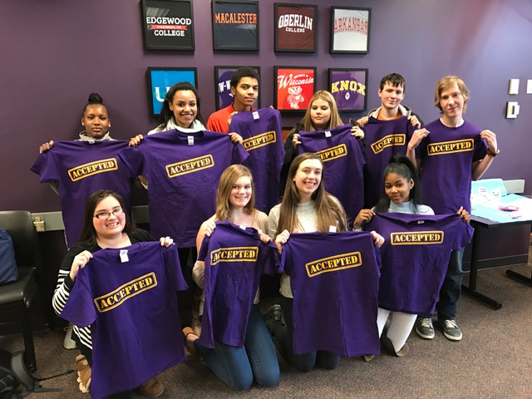
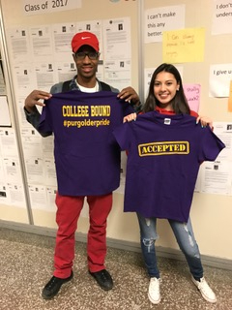
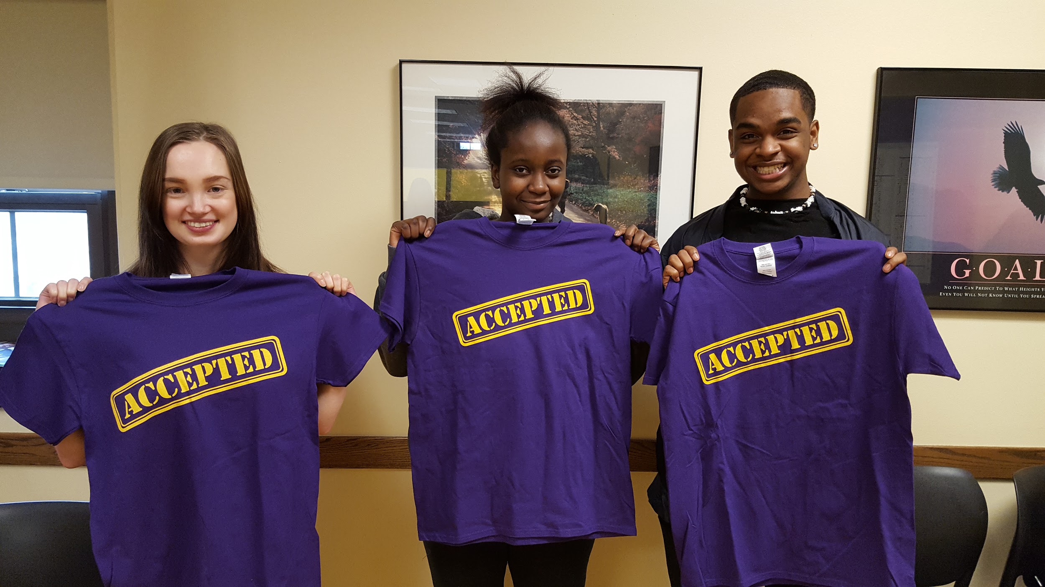
Celebrations!
Announcements of Acceptance (FB, and Slide Show)
Raffle for tasks completed
T-shirts
Winners of daily drawings on the Announcements

Slide 9
Simple Ways to Create a College Going Culture and Your School
College Wear Days
College Application Week
College Boot Camps
Celebrations of Accomplishments
Parent Nights
Create Visuals or Bulletin boards on college and career aspirations
Staff Post the Name of their Alma Mater in Classroom
College Door Decorating Contest
Have Teachers Speak to Students about their college experience
Academic and Career Planning
Encouragement to Enroll in Rigorous Coursework (AP)
Notes:
Pictures of Doors from Steve
PBS Lesson Linked In

Slide 10
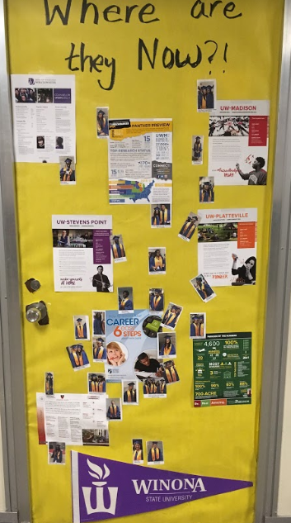
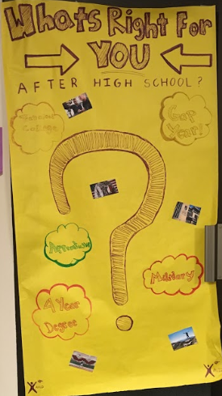
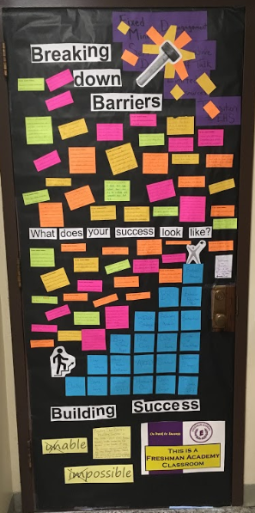

Slide 11
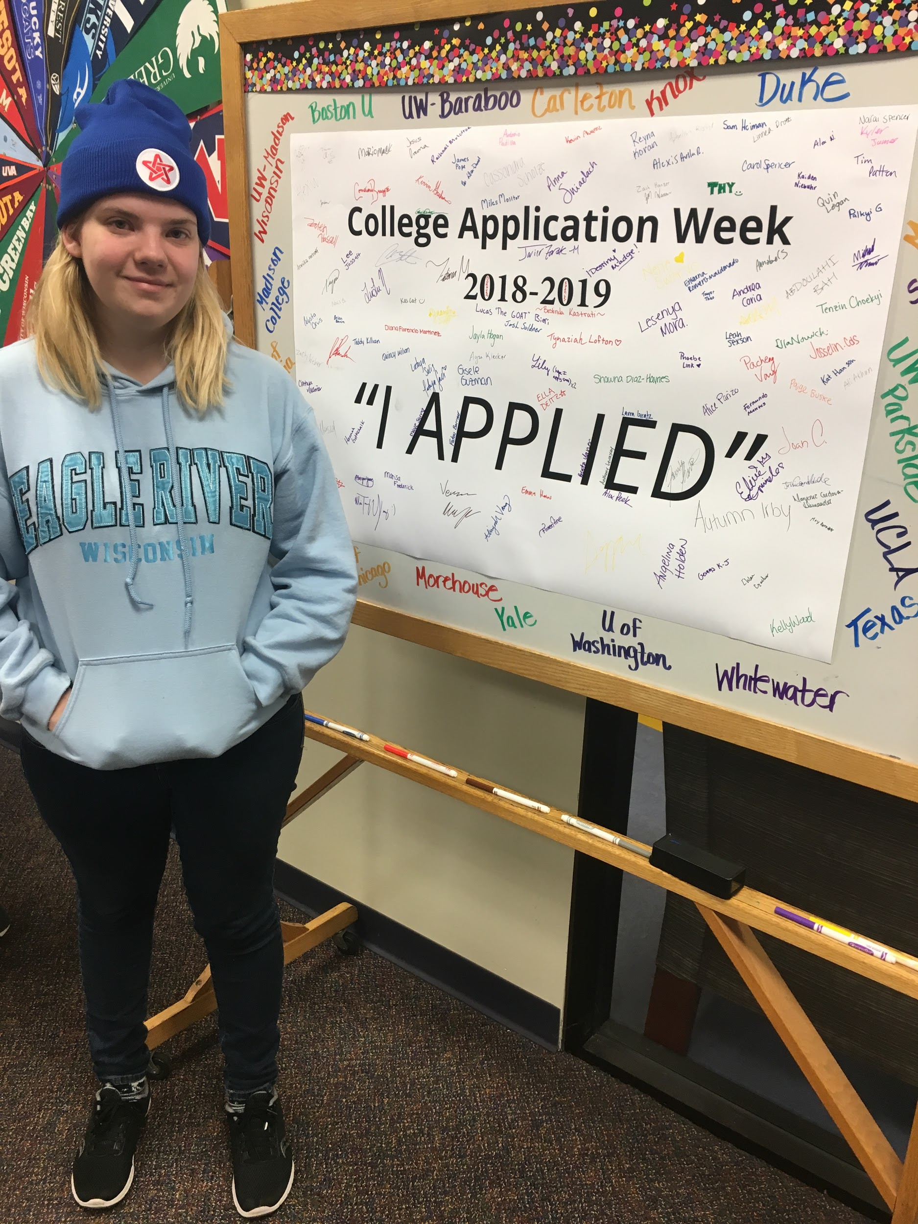
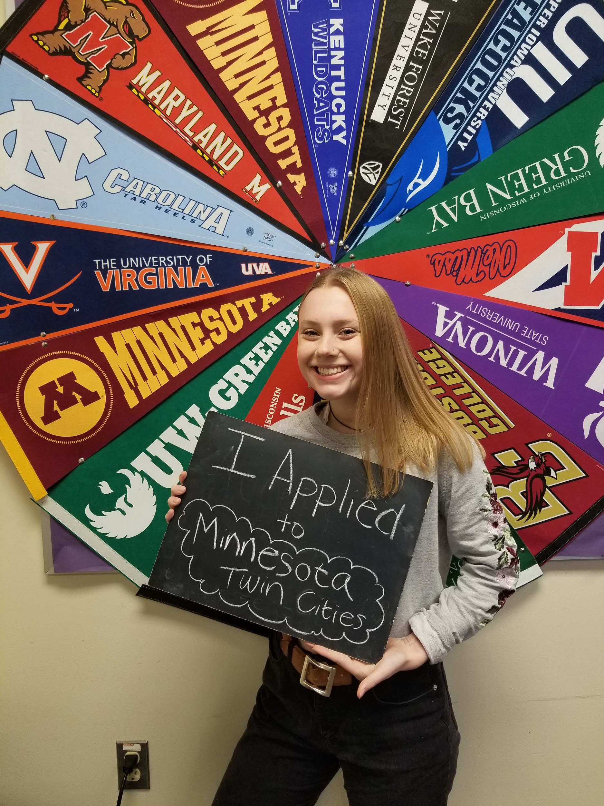
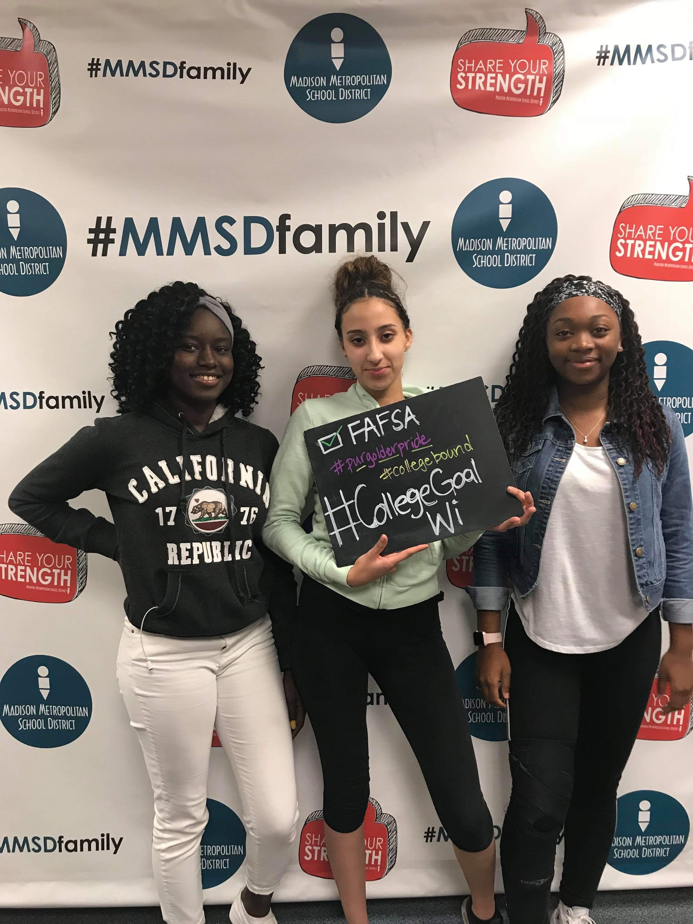
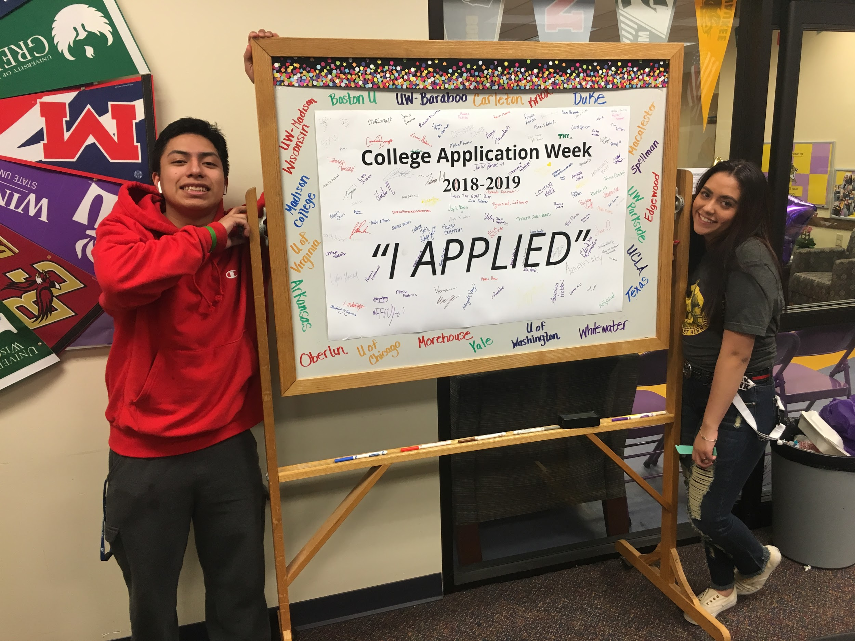
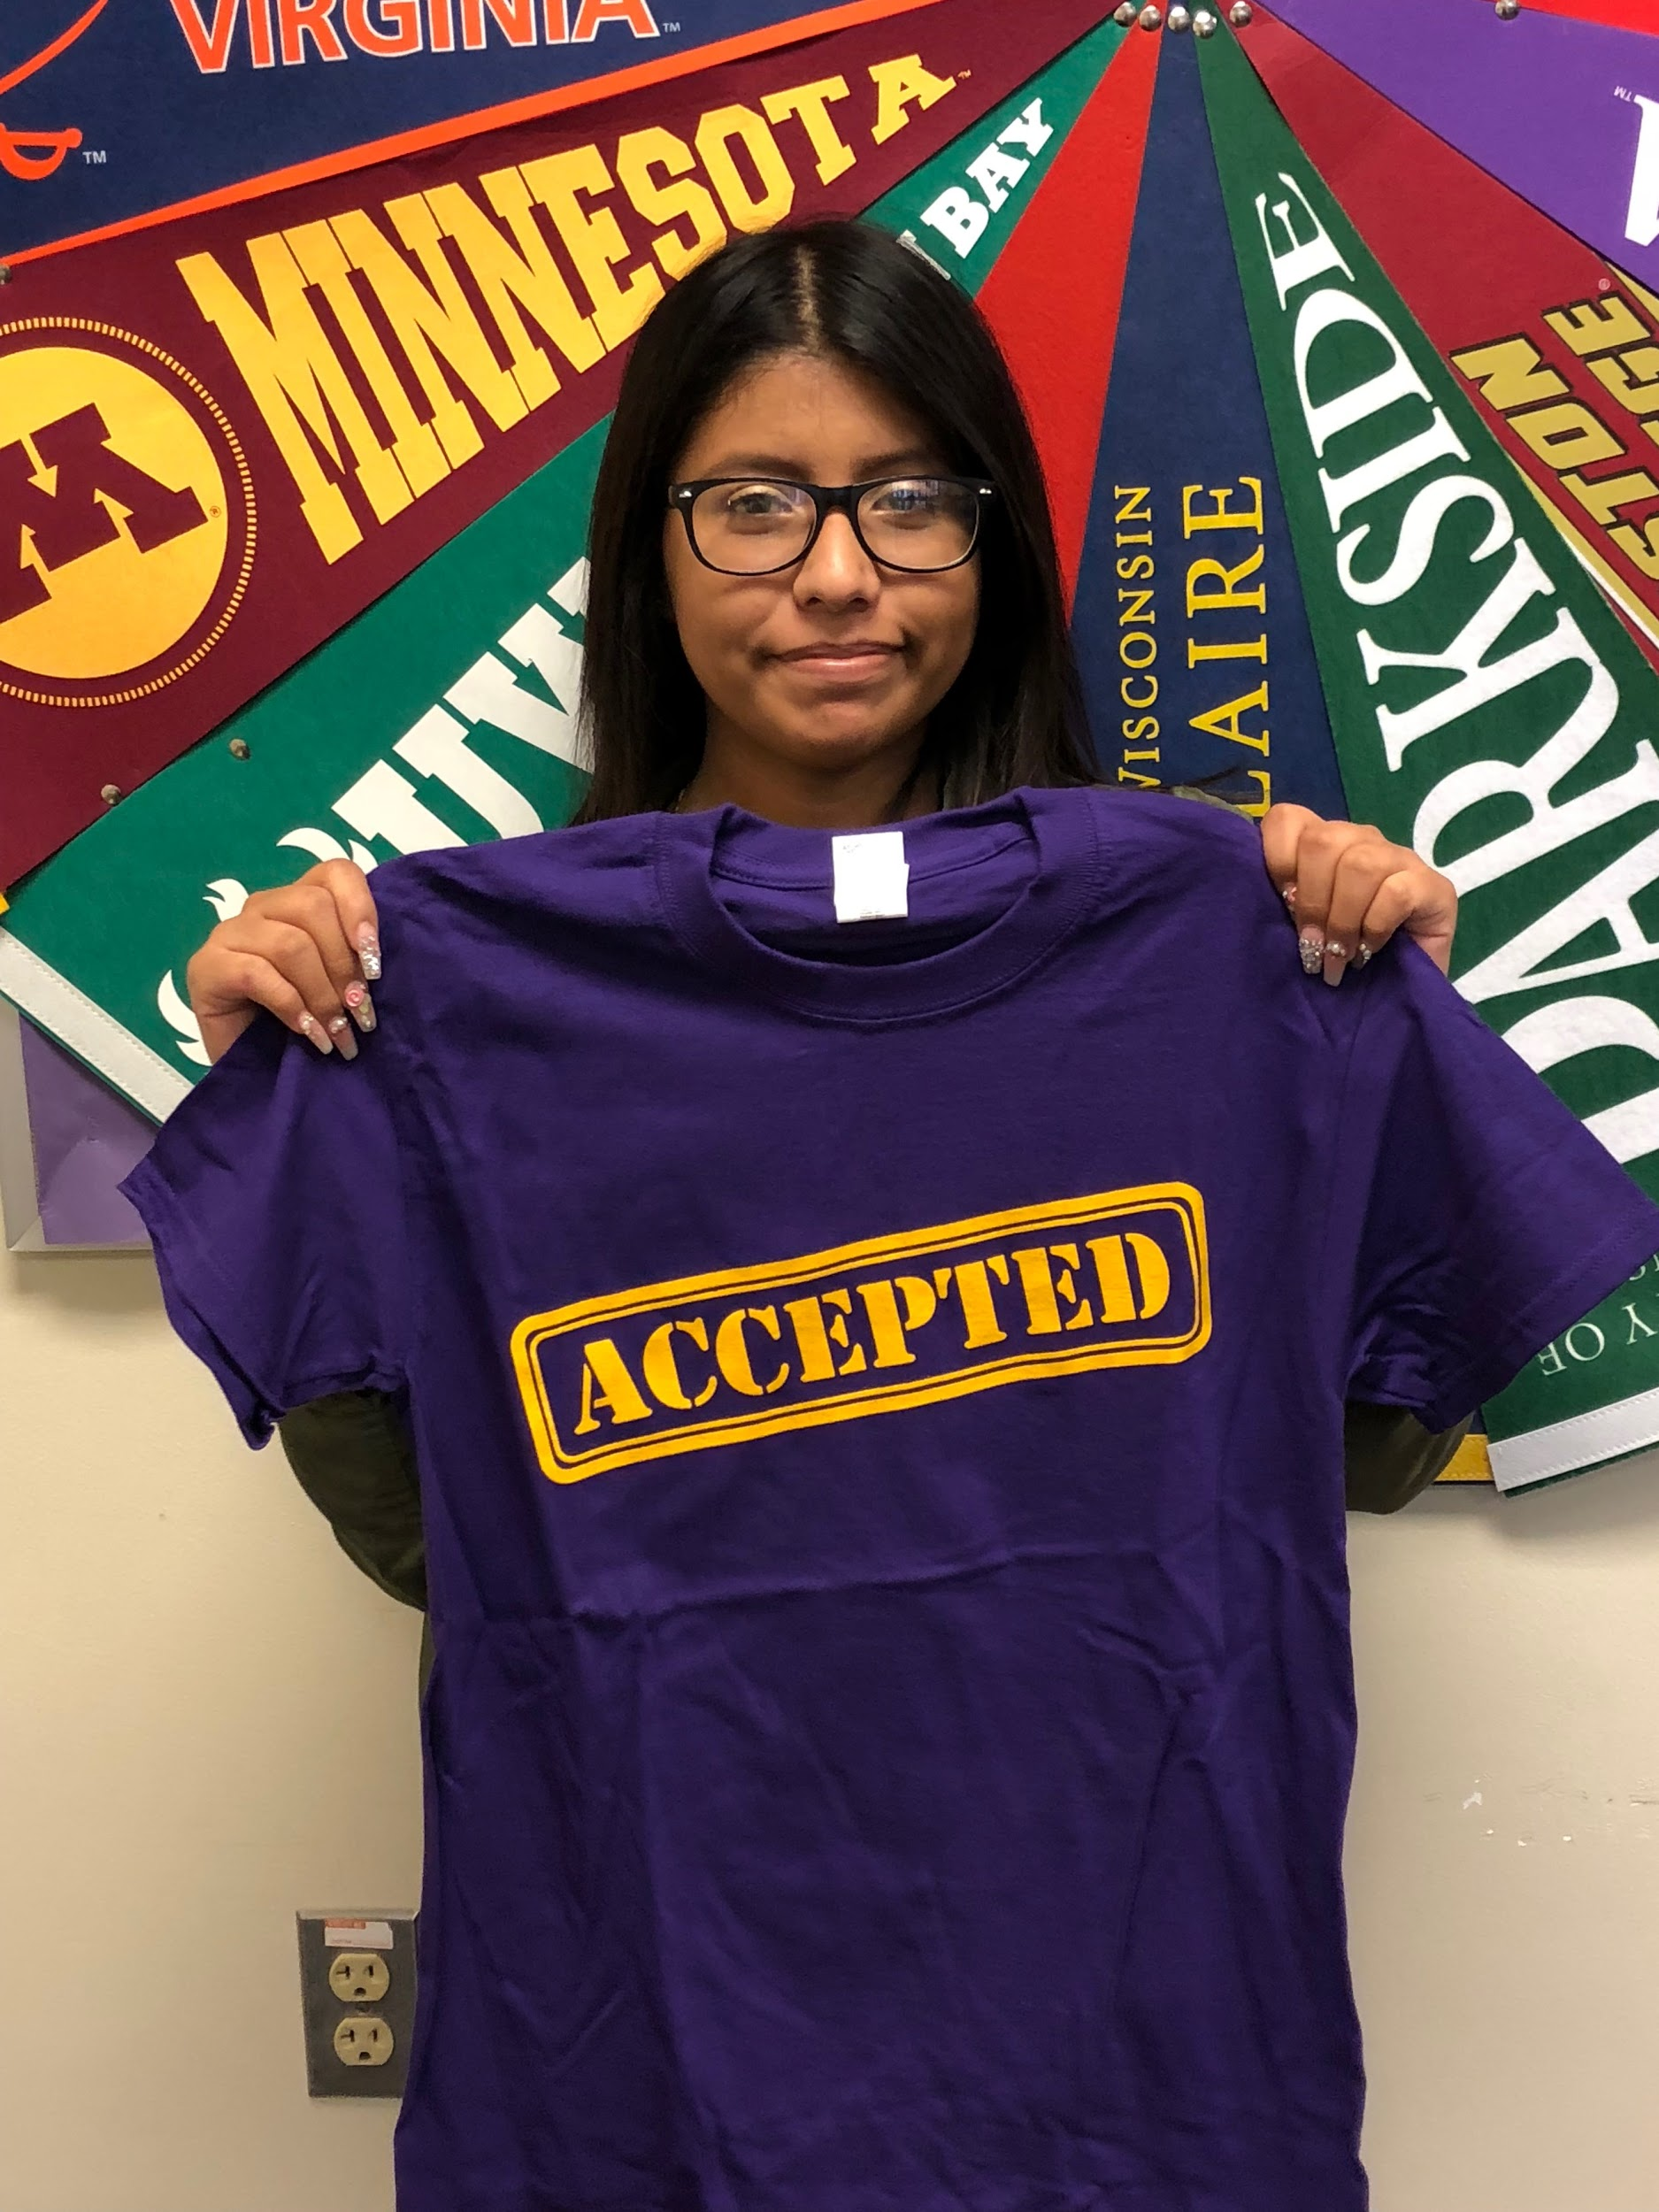
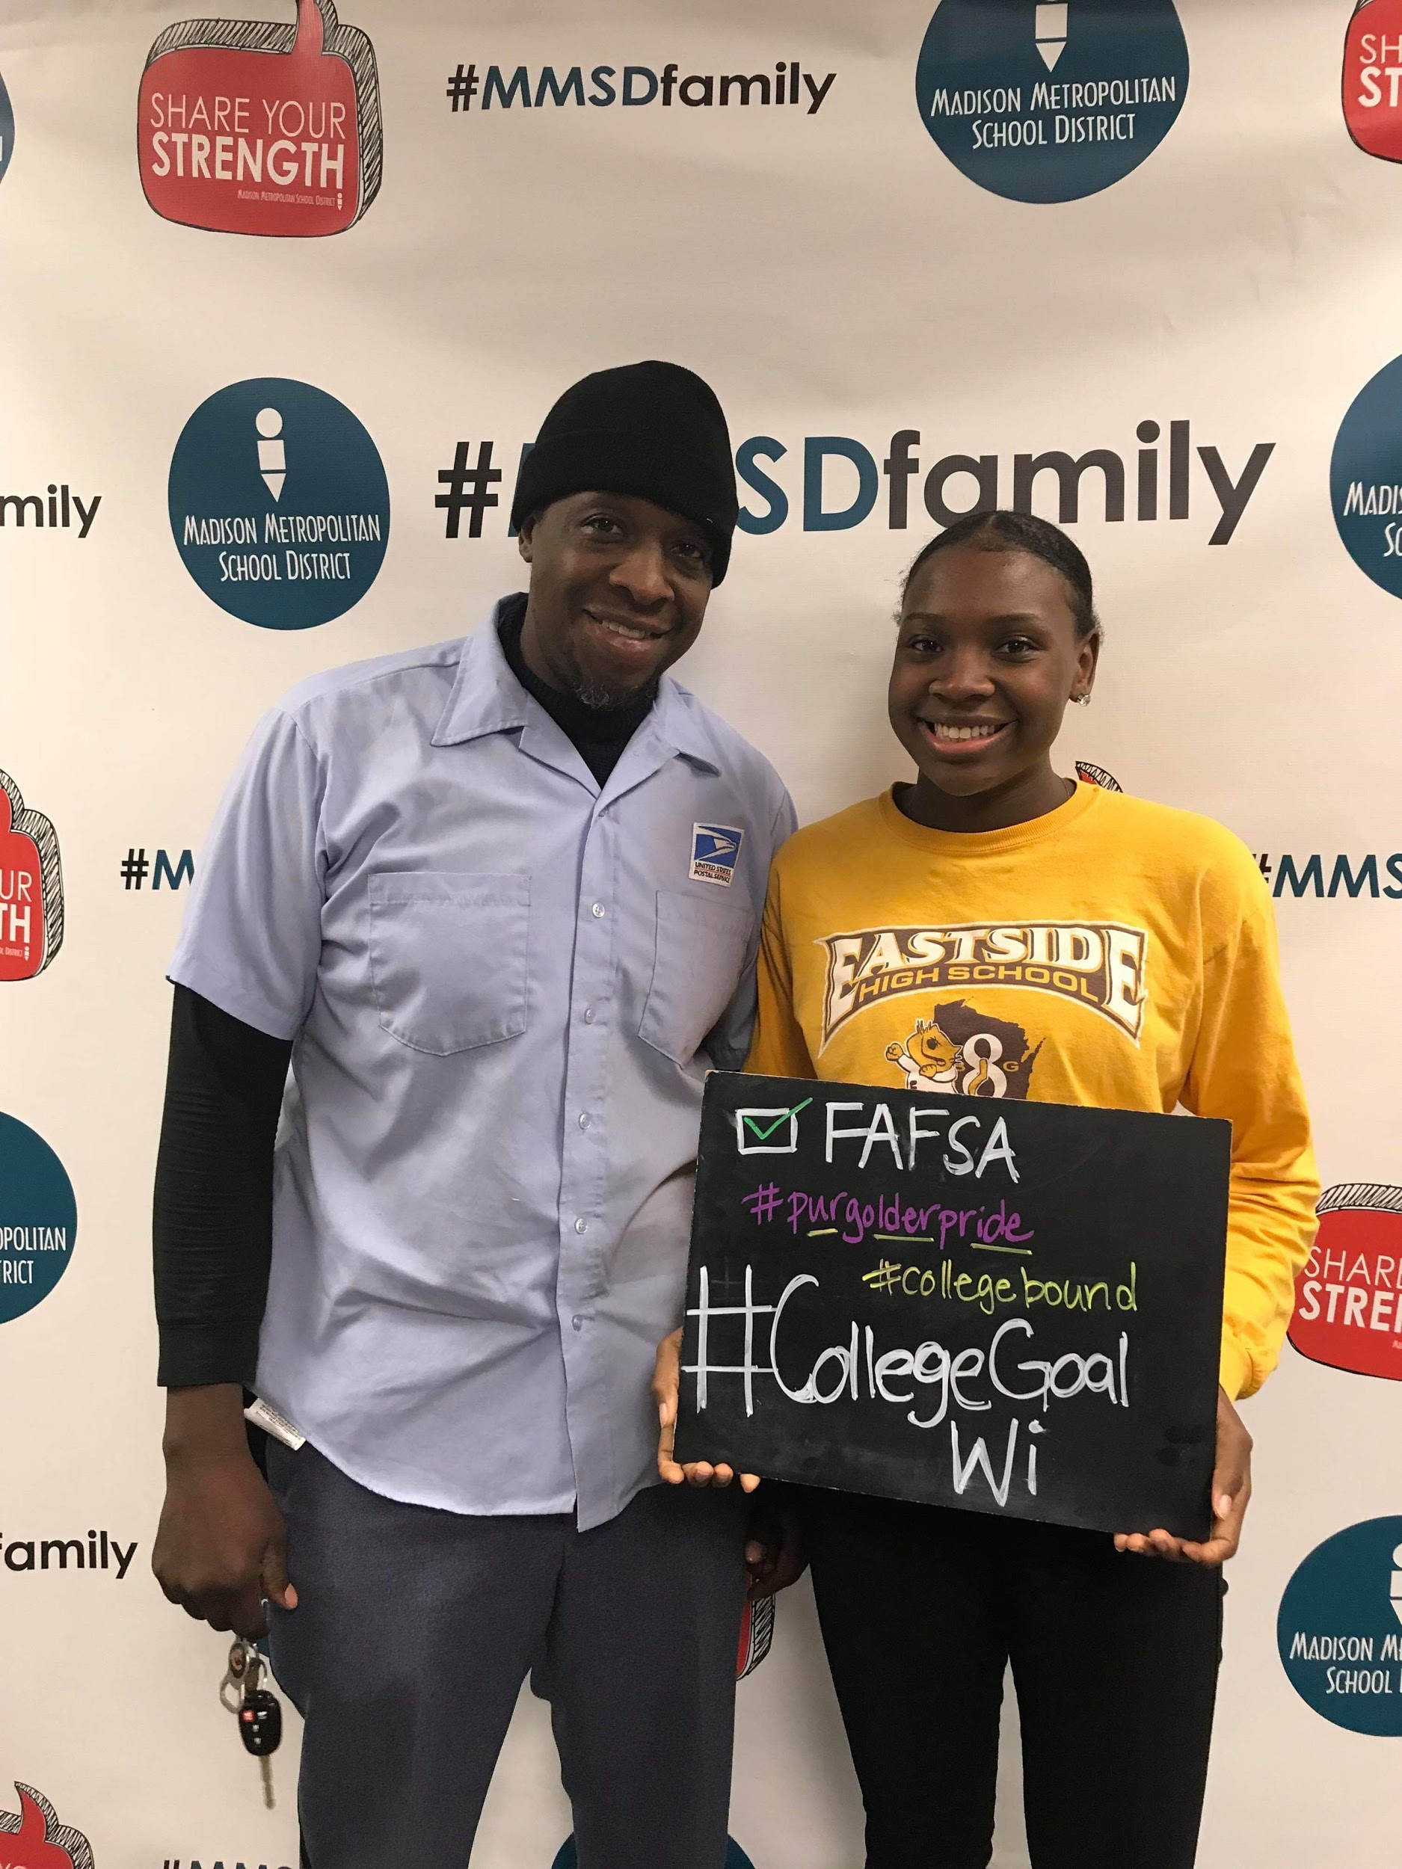
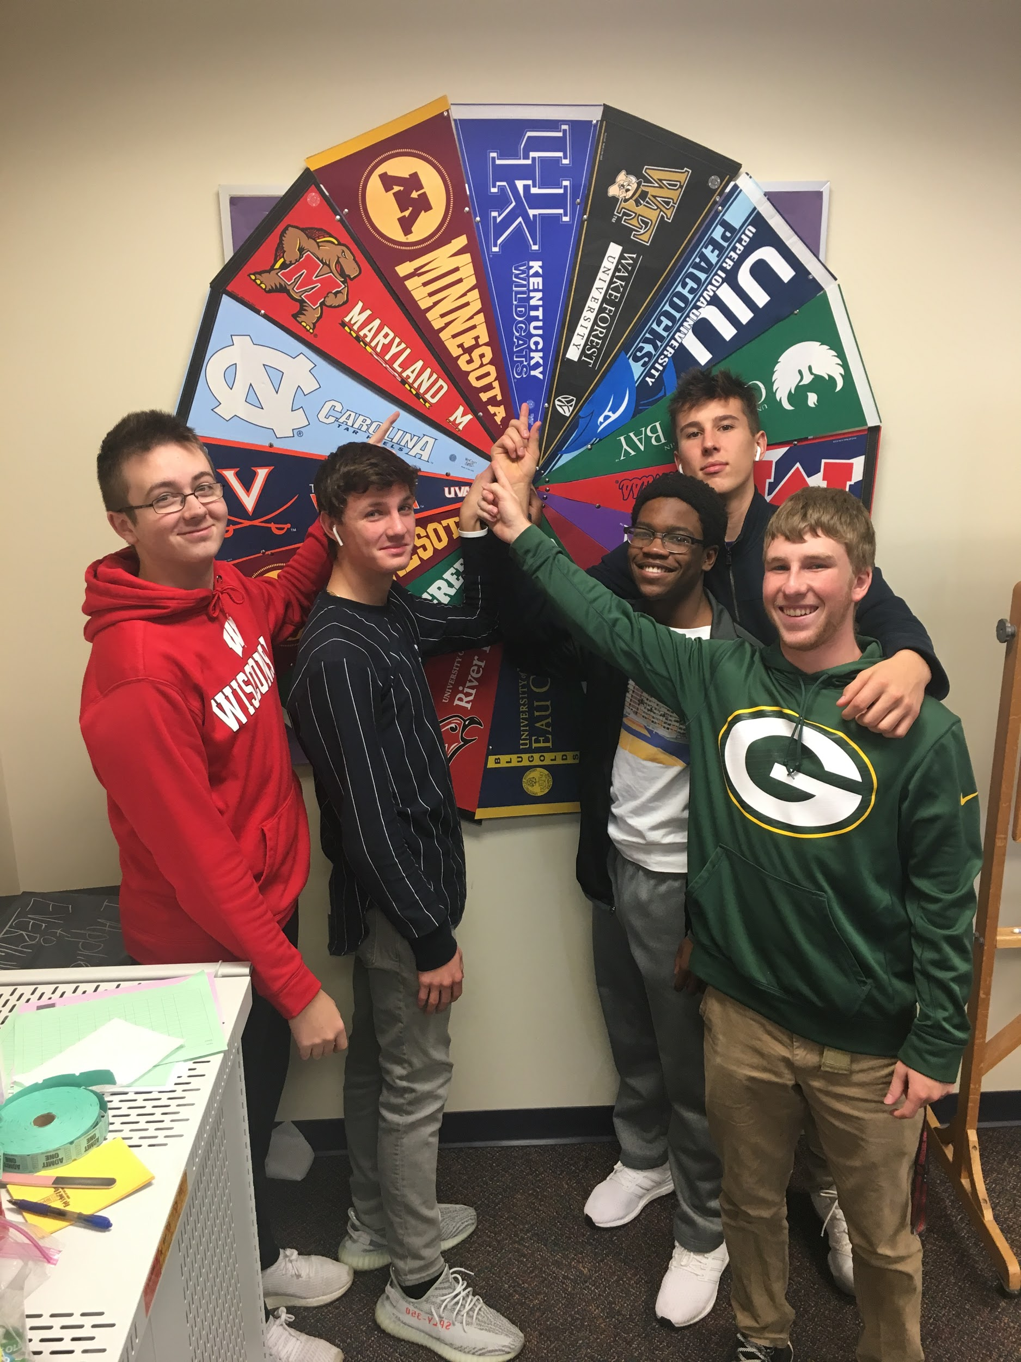
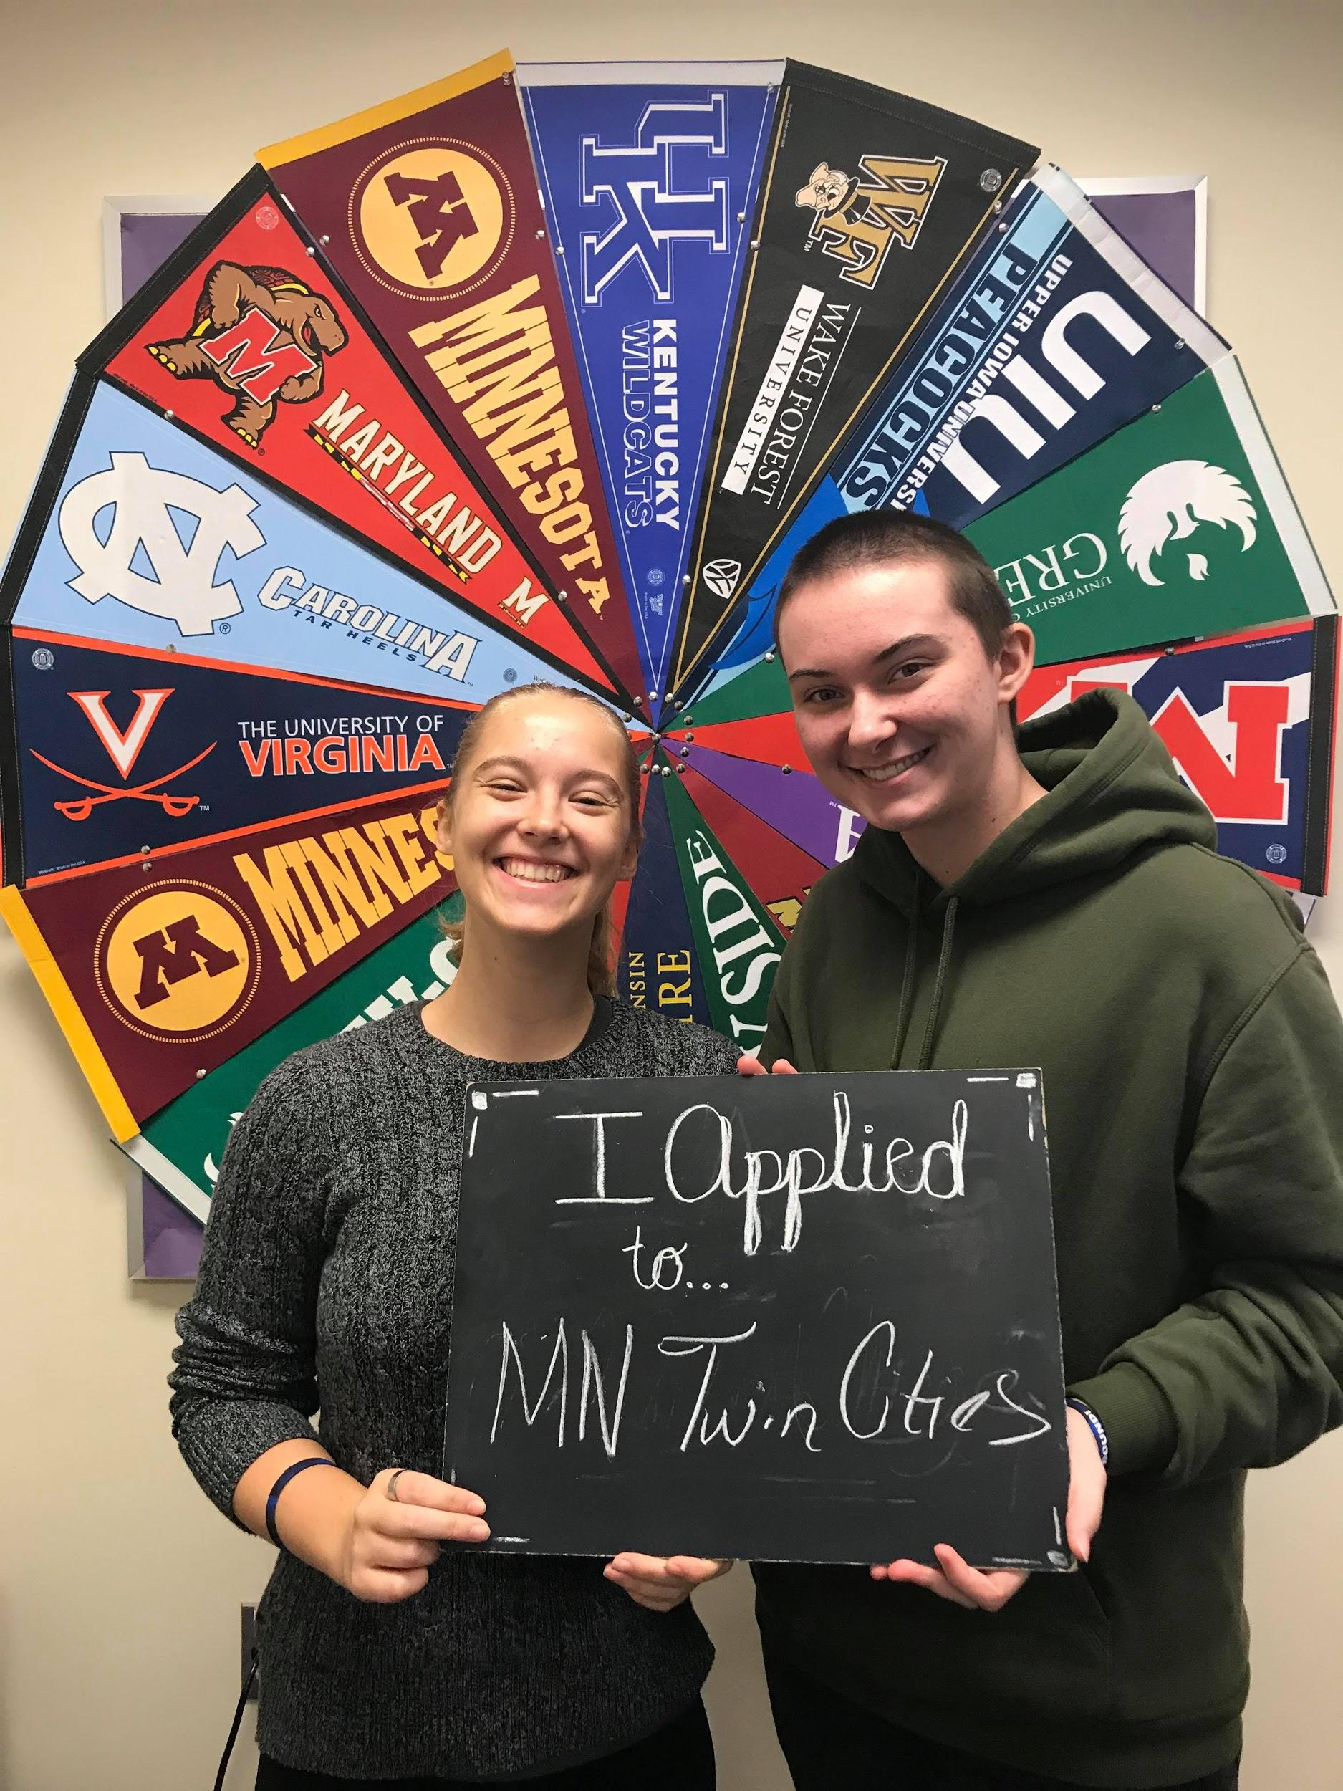
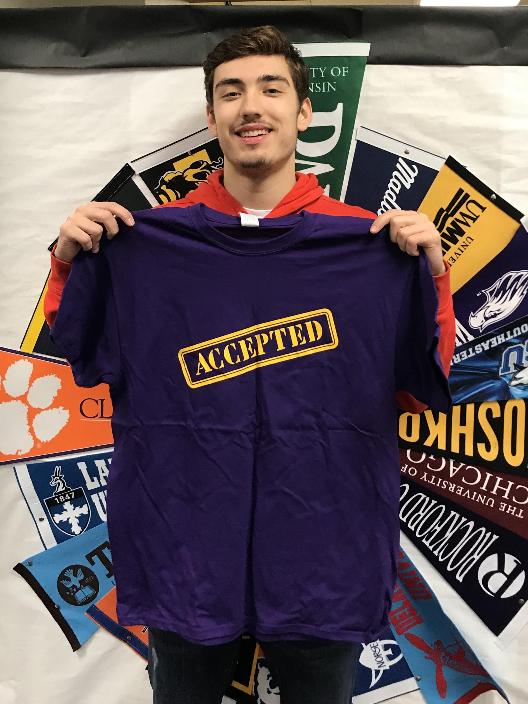
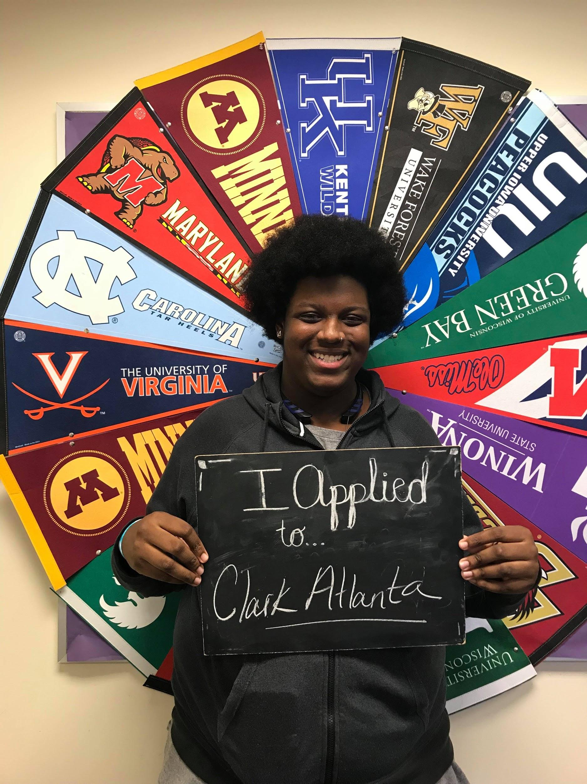
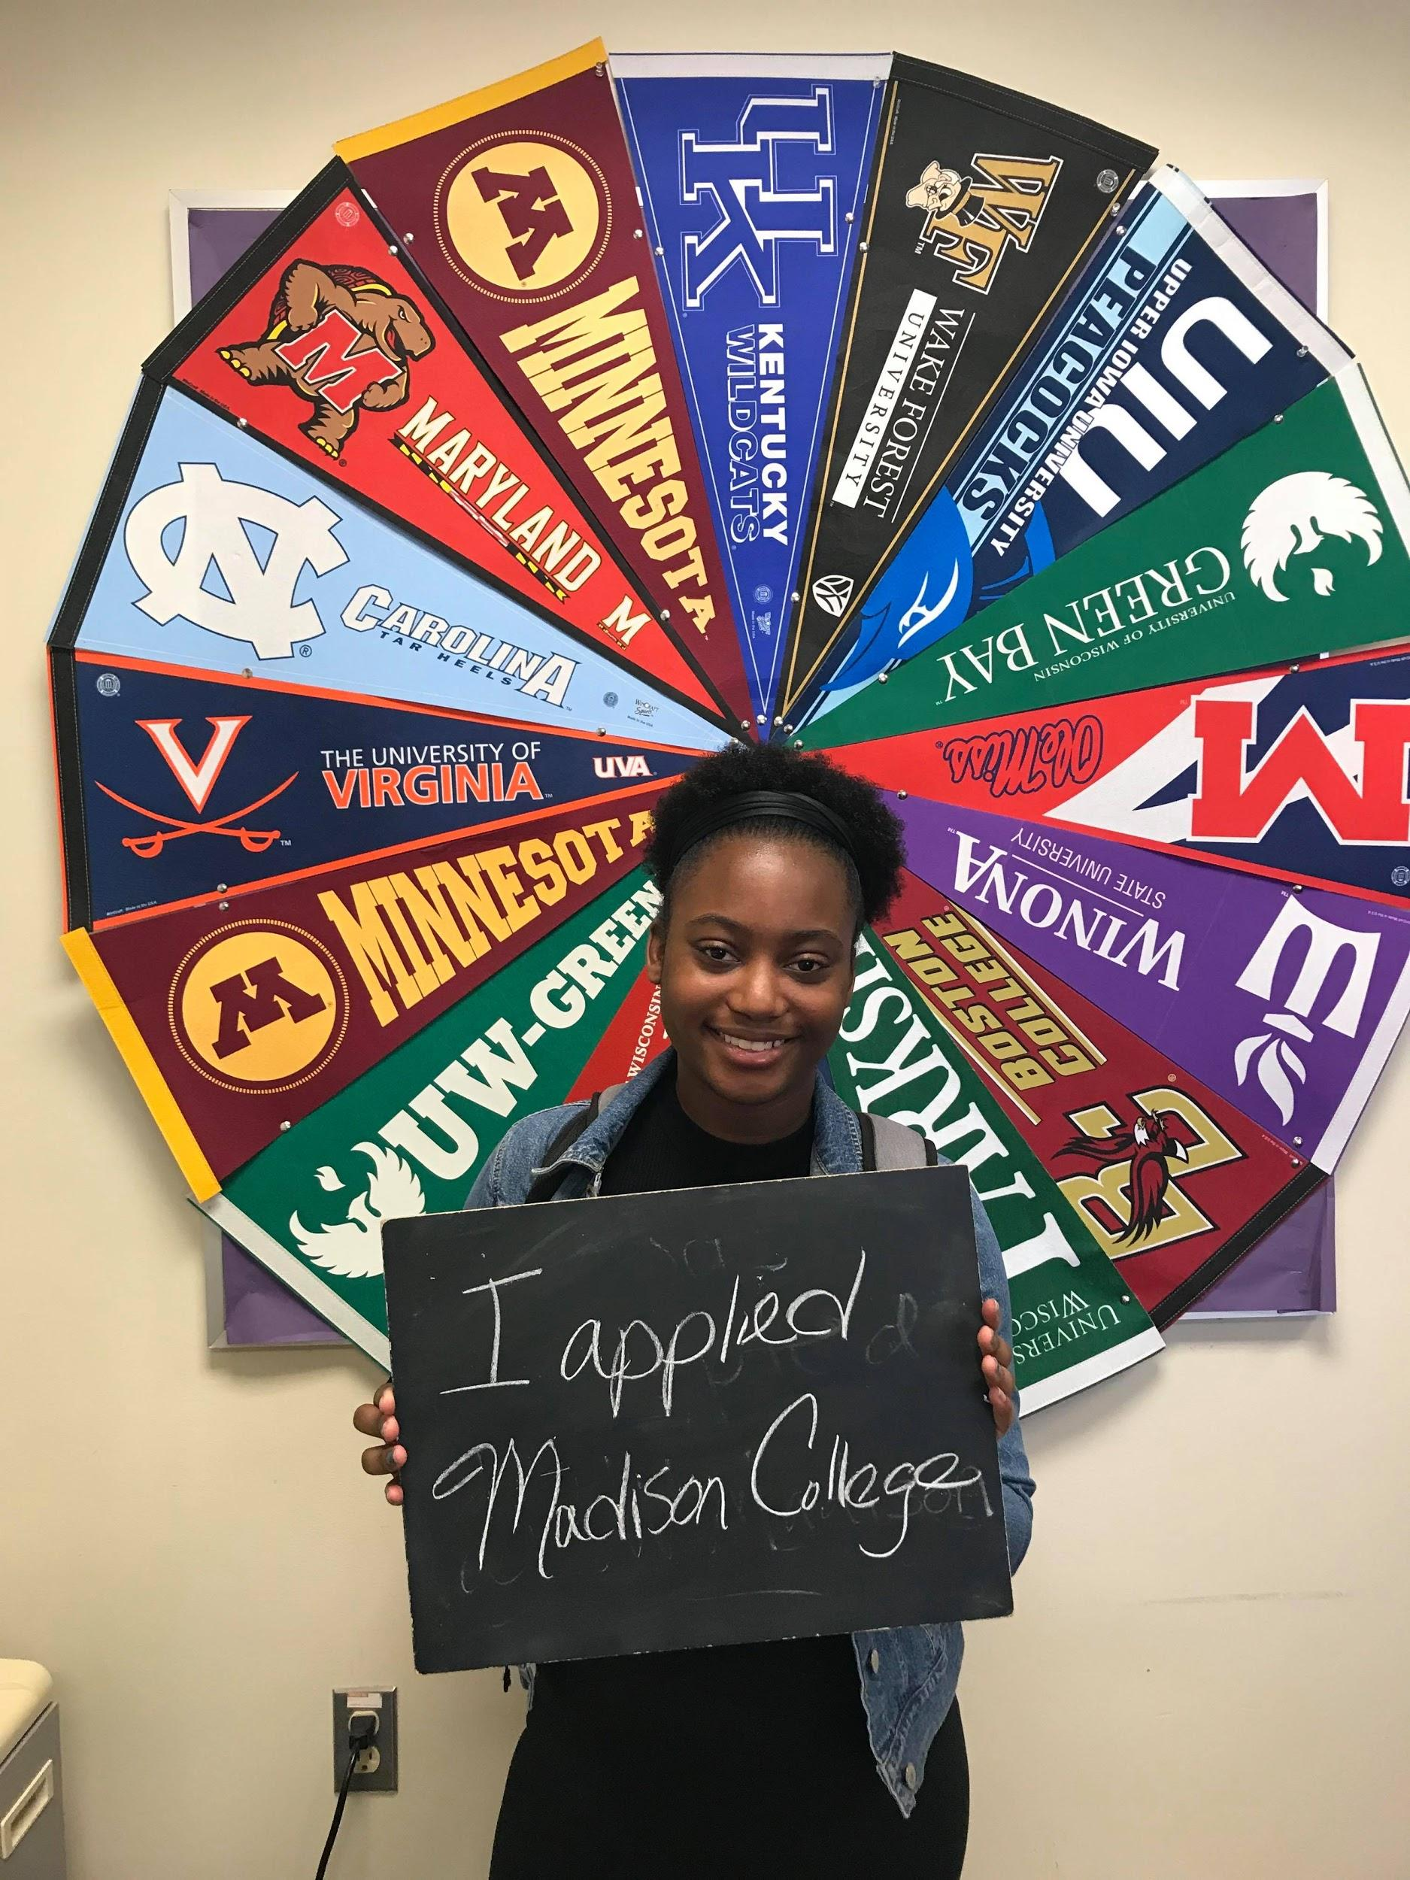
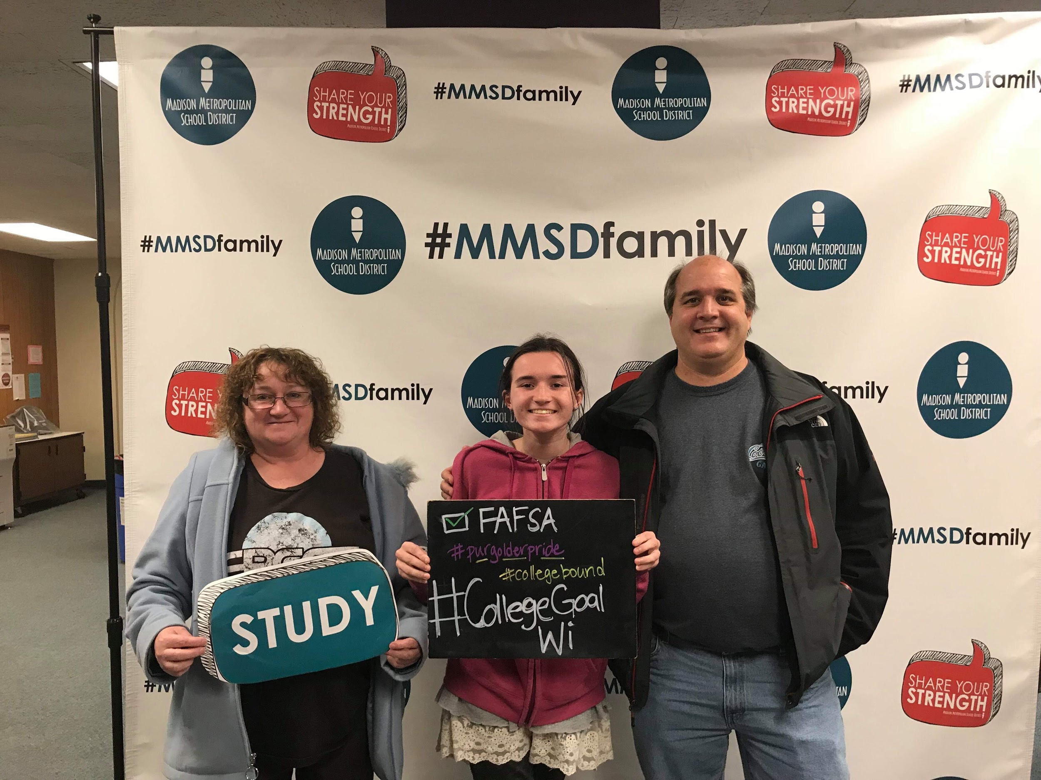
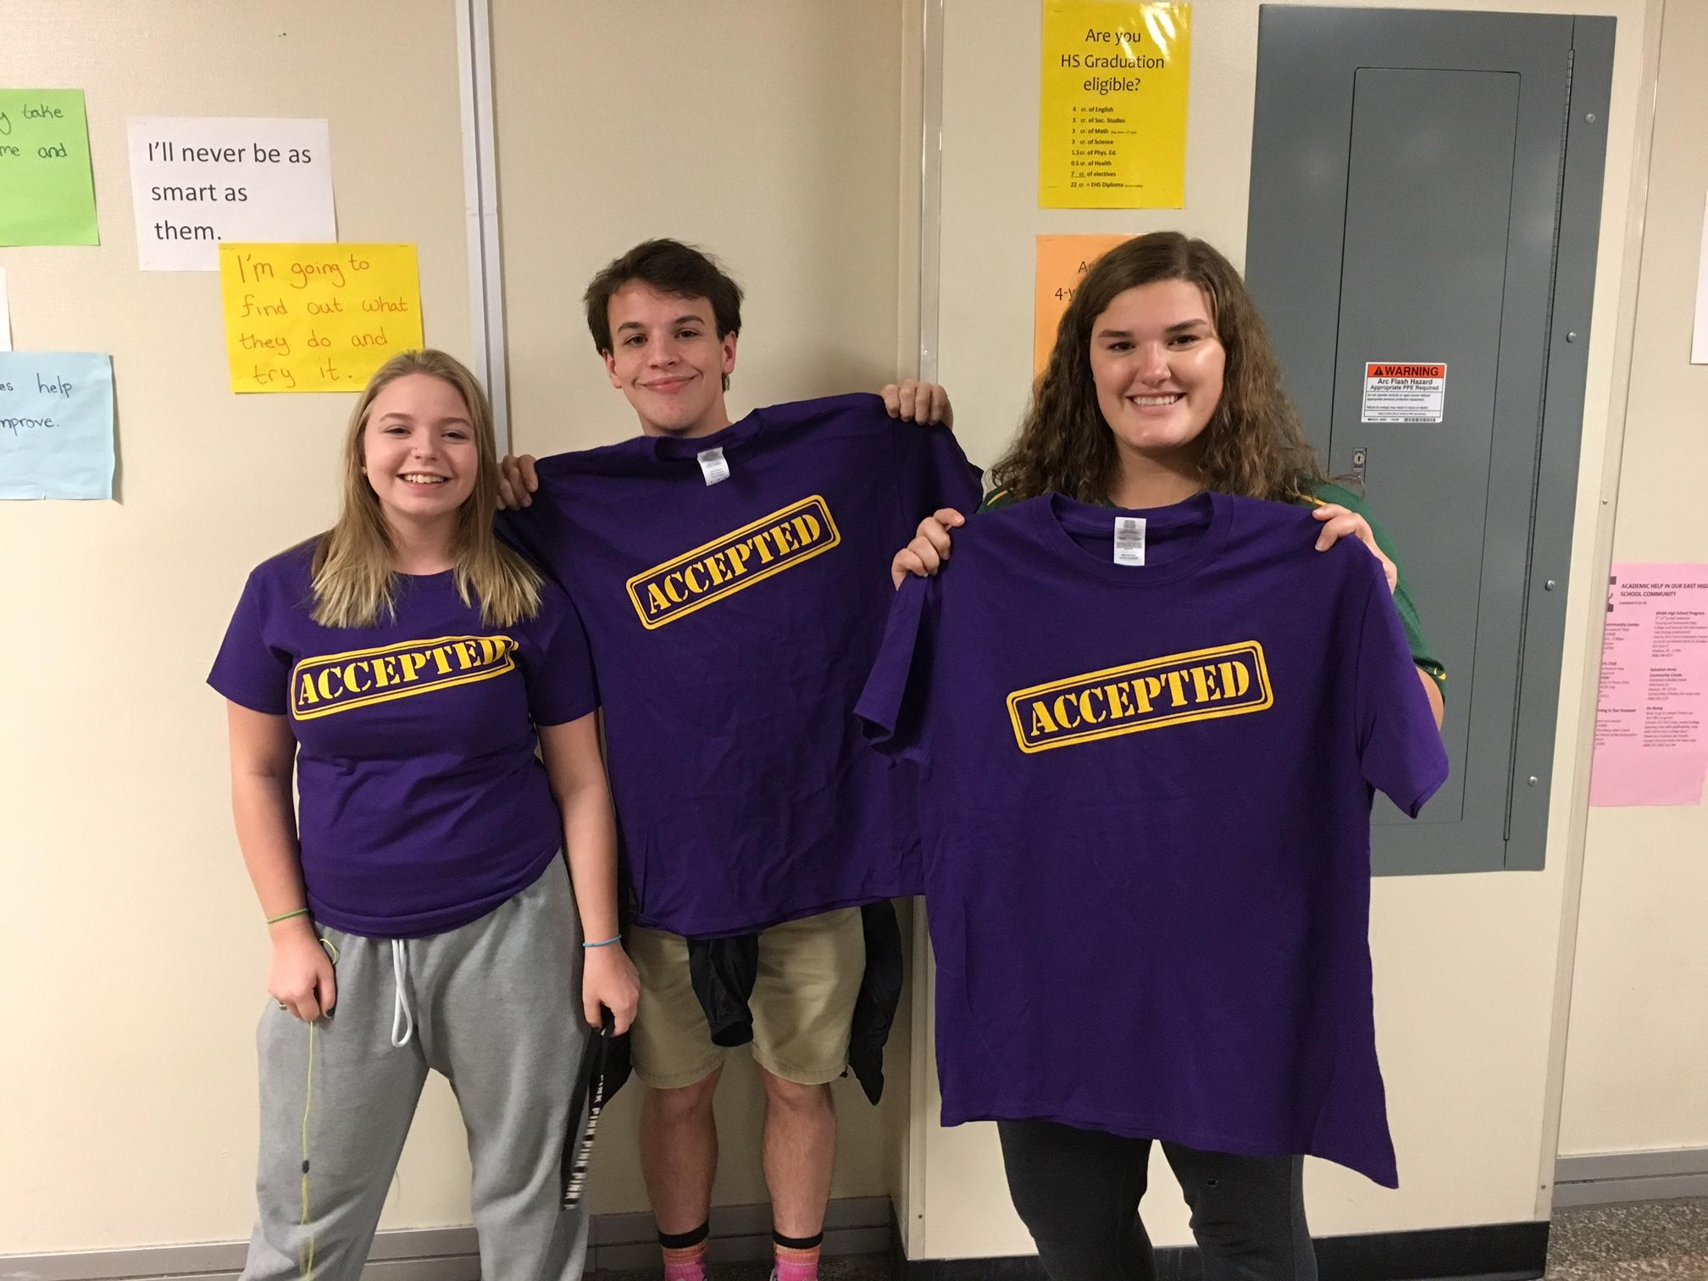
College Application
Week Data! (LINK)

Slide 12
Resource Page
College Going Culture Strategies
Letter of Rec Guide
College Checklist
College Application Monitoring
Fall 2018-2019 UW Application Essays
Scholarship Deadlines for UW-System New Freshmen
UW System Tuition Rates 2018-19
2018-2019 Common Application Essay Prompts
Student Brag Sheet for Letters of Rec
Teacher Recommendation Narrative Form
Parent Brag Sheet for Letter of Rec
Parent Brag Sheet in Spanish for Letter of Rec
NCAA Application
ACT How to Send Scores
FSA ID TIPS
College Application Week Evaluation Survey

Slide 13
Questions ???

